Slide 1
Multi-agency Consultations
By Lola Stith
NOAA FOIA Office
January 14, 2025

Slide 2
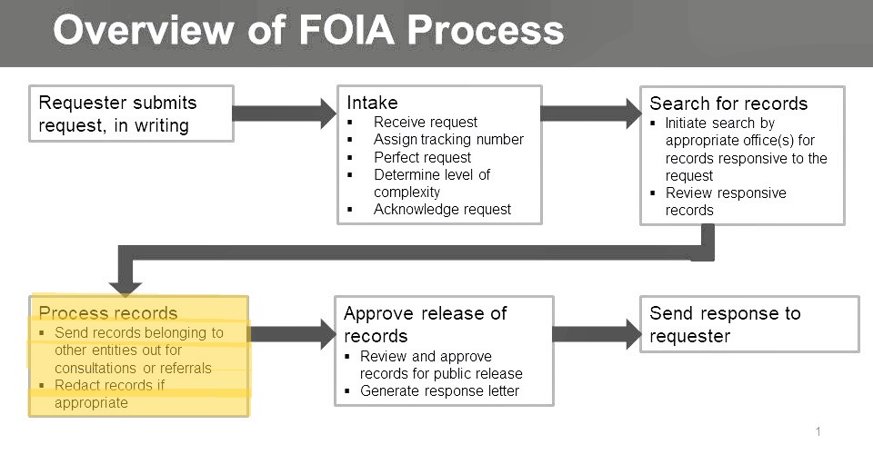
Overview
Provide NOAA FOIA staff with clear guidance on consultations and referrals
Discuss challenges specific to NOAA’s mission and responsibilities

Slide 3
Outline
Primary Considerations:
When is consultation or referral required
Consultation vs. referral: Key differences
Addressing non-responsiveness
Responsibility for asserting denial
Litigation considerations

Slide 4
When is Consultation or Referral Required
Definition and Importance:
Consultation: Another agency needs to weigh in on NOAA records
Referral: Records belong to another agency and are better processed by them
Example:
Consult: Scientific research with national security implications
Refer: Climate data that originated with NASA or USGS

Slide 5
NOAA-Specific Case Studies
Case Study 1: Consultation on Fisheries Data
Scenario: NOAA holds records related to a joint research project with USGS
Action: NOAA consults USGS for review before release
Outcome: USGS identified sensitive data protected under Exemption 5
Case Study 2: Referral of Satellite Data
Scenario: NOAA identifies FOIA records for weather satellite images originating from NASA
Action: NOAA refers the records to NASA
Outcome: NASA processes and communicates the response to the requester

Slide 6

Consultation vs. Referral
When to Consult: NOAA retains primary responsibility for the response but seeks input (e.g., proprietary industry data)
When to Refer: Another agency has ownership of the record (e.g., interagency marine science reports)
Key Considerations: Communicate distinctions clearly to avoid confusion or delay

Slide 7

What Happens if They Don’t Respond
Challenges:
Other agencies delaying responses can harm NOAA’s FOIA deadlines
Administrative bottlenecks lead to requester dissatisfaction
NOAA Strategies:
Schedule regular follow-ups with the consulted/referred agency
Use interagency FOIA liaisons for escalation
Document communication efforts in NOAA’s FOIA case file

Slide 8
Who Asserts the Denial?
Key NOAA Rule:
NOAA asserts denial if it retains final authority over the records
Referred agencies assert denial for records they own
Example Scenarios:
NOAA applies Exemption 3 for sensitive marine species data after consulting with the Department of the Interior
A referral to the Navy results in them asserting Exemption 1 for national security

Slide 9
When It Goes to Litigation
Litigation Triggers:
Failure to meet deadlines due to delays in consultation or referral
Disagreement over exemptions (e.g., NOAA's application of Exemption 5)
NOAA’s Role in Litigation:
Provide a clear administrative record of processing efforts
Collaborate with NOAA legal counsel and referred/consulted agencies
Best Practices - Be proactive! NOAA should demonstrate good faith throughout the process

Slide 10
Best Practices for NOAA FOIA Staff
Identify consultations/referrals early, especially for interagency records
Communicate promptly with external agencies and requesters
Keep detailed records of NOAA’s processing efforts
Regularly monitor NOAA’s statutory deadlines to ensure compliance
Prepare for litigation with comprehensive and transparent documentation

Slide 11

Conclusion
NOAA’s unique mission requires precision in handling consultations and referrals
Collaboration, documentation, and transparency are key to NOAA’s FOIA success
By adhering to these best practices, NOAA can meet legal obligations while fostering public trust

Slide 12
QUESTIONS?
QUESTIONS?

