Slide 1
The Office of Government Information Services (OGIS)
Martha Murphy, OGIS Deputy Director
Notes:
Slide 1 [Title Slide] - ALINA & JESSIE
Good afternoon everyone.
We are so excited to be with you today, and very grateful for the opportunity.
Introduce Alina:
I would like to thank Toni Fuentes and Tammy Hickey - and of course Joo Chung - for the kind invitation to come and speak with you today.
For those of you who don’t know me, I am Alina Semo; I was appointed by the former Archivist of the United States David Ferriero as the Director of the Office of Government Information Services - or OGIS - in December 2016.
I have a fairly long history of working in FOIA, reaching all the way back to a stint as a law clerk in what was then called the Office of Information and Privacy at the U.S. Department of Justice. Somehow throughout my career I have not been able to escape FOIA for very long: I handled FOIA litigations as an attorney in the Federal Programs Branch at the Department of Justice. After 9/11, I also set up the team that handles FOIA litigation at the FBI and continued to work on FOIA cases as the Director of Litigation at the National Archives prior to my current position.
Introduce Jessie
Today, we want to introduce you to our office—who we are, why we exist, and how we work—and share with you some insight into our processes.
Before we get started, a show of hands, please: how many of you are or function as your agency or component’s FOIA Public Liaison? [Discuss results].
How many of you have interacted with OGIS before? [Discuss results]
We hope you’ll leave here today with an understanding of the work we do -- how it fits with the work you do -- and how we can work together to make FOIA better!
And hopefully after today, any apprehension about contacting OGIS, or us contacting you about a FOIA request, will be gone!

Slide 2
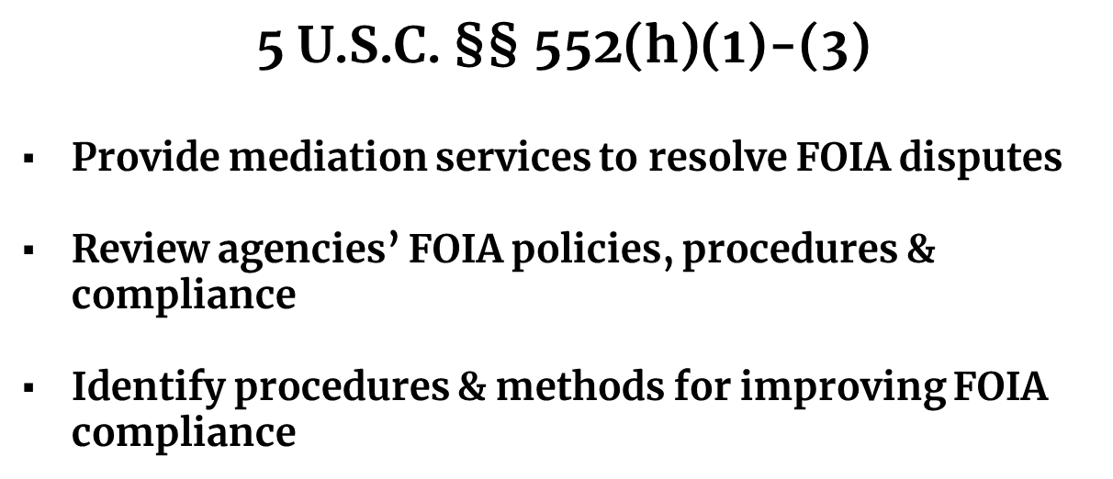
OGIS’s Mission
Notes:
Slide 2 - JESSIE
OGIS was created by the OPEN Government Act of 2007 and we opened our doors in September 2009. Our mandate was expanded with the FOIA Improvement Act of 2016
So what is OGIS’s Mission? OGIS functions as the FOIA Ombudsman for the Federal Government. In this role we provide mediation services to resolve FOIA disputes - as a non-exclusive alternative to litigation; we review agencies’ FOIA policies, procedures and compliance; and identify procedures & methods for improving FOIA compliance.
Although the statute doesn’t use the word “ombuds,” the legislative history is clear: Congress intended for us to be the FOIA Ombuds — a neutral entity that works to resolve complaints and identify systemic issues
We are, quite simply, advocates for the FOIA process.
The FOIA Improvement Act of 2016 mandated that agencies inform requesters of OGIS’s dispute resolution services whenever there is an adverse determination. Those of you who work as FOIA professionals likely have added our contact information to your standard FOIA letters.
Since 2016, FOIA requesters may come to OGIS for dispute resolution at any point in the process.
And although requesters and agencies can have a positive FOIA experience without OGIS intervention, we can provide and be a tool to improve relationships, communications, and experiences throughout the process.

Slide 3
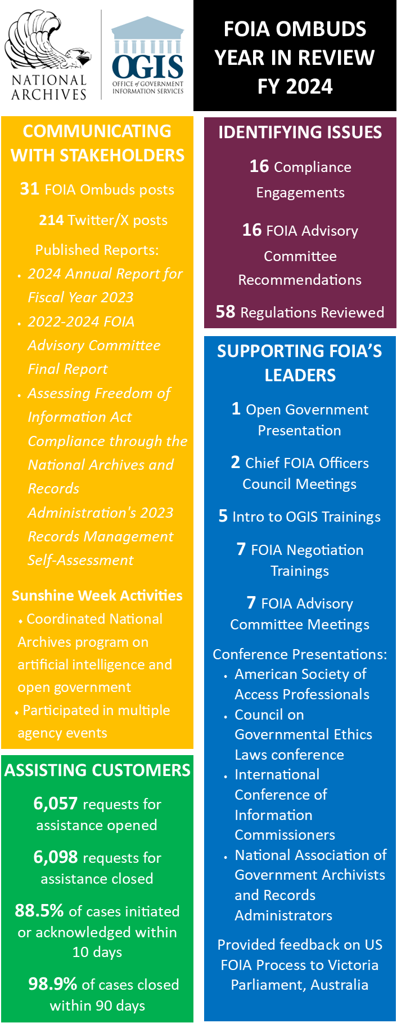
CHIEF FOIA
OFFICERS COUNCIL
DISPUTE
RESOLUTION
FOIA OMBUDSMAN
EDUCATION
OUTREACH
TRAINING
ADVISORY
OPINIONS
COMPLIANCE
FOIA FACA
Notes:
Slide 3 - ALINA
This slide is a summary of all of the ways in which OGIS fulfills the legislative mandate we’ve been given.
We’re going to touch only briefly through most of the spokes of the wheel to tell you more about the work that we do - but today we’ll focus most of our time on our Dispute Resolution practice.
Our overarching goal in all of our work is improving the FOIA process for all – both for requesters and agency FOIA professionals alike
On this slide is a snapshot of all of our activities - we have had a busy year!
That includes handling over 5500 requests for assistance—from both FOIA requesters and agencies.
OGIS has developed a robust compliance program. We produce several different compliance products which I’ll discuss in a moment.
We also reach out to the FOIA community by participating in a variety of different forums and through publications on our website. We publish the FOIA Ombuds Observer, which is written for the requester community and covers issues from the requester perspective. We have issued some Advisory Opinions, which offer legal analysis of a FOIA issue. We attend meetings with civil society groups to hear their concerns and exchange ideas.
I co-chair the Chief FOIA Officers Council along with OIP’s Director, Bobby Talebian; the Council’s creation was mandated by the FOIA Improvement Act of 2016. More about that in a minute.
I also chair the FOIA Advisory Committee, which is made up of FOIA professionals and representatives from the requester community. I’ll talk a bit more about the Committee shortly.

Slide 4

Compliance: Not the FOIA Police!
Website/Contacts on FOIA.gov
Letters
Patterns
Regulations review
Estimated Dates of Completion!
Notes:
Slide 4 [Compliance Team] - ALINA
While our role in the statute is clear vis-a-vis reviewing agencies’ FOIA policies, procedures and compliance, we are not the FOIA police.
When OGIS assists requesters and observes a compliance issue, we work to ensure that FOIA is working.
How we do that:
Website/Contacts on FOIA.gov: if we see incorrect information on an agency’s FOIA website or on FOIA.gov, we will inform the agency of the error and ask that it be corrected.
Letters: if we see agency response letters that have compliance issues, we will inform the agency about our observations. We recently observed letters which were missing crucial information about the agency’s search for and review of any responsive records. We informed the agency of this deficiency and it was corrected. We have informed agencies about deficiencies in letters regarding the appeal time given to requesters.
Patterns Example: we constantly look for patterns, which in a process as varied as FOIA across the government can be difficult. But estimated dates of completion are a perfect example of a pattern that cuts across agencies. Our observation is what sparked the assessment and advisory opinion that we just mentioned.
We get a lot of requests from individuals who want us to assess agency compliance because they are unhappy with a FOIA response

Slide 5
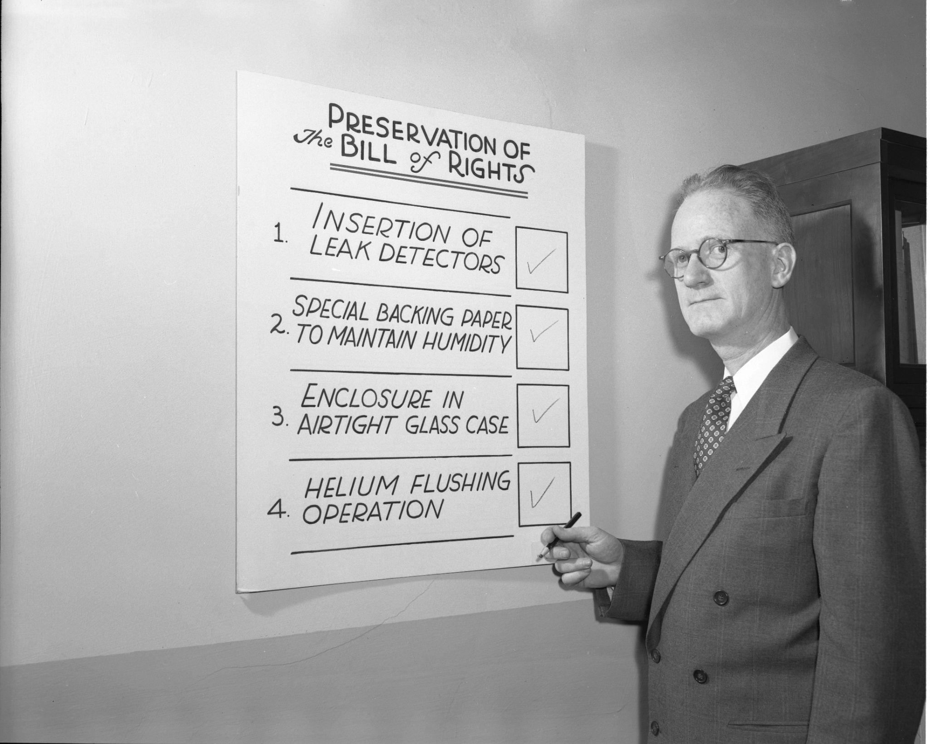
Compliance: Assessments
14 assessments of agency FOIA programs
11 assessments of FOIA issues cutting across most or all agencies
Notes:
Slide 5 [Compliance Assessments] - ALINA
To be clear we are not Inspectors Generals, nor are we the Government Accountability Office
We conduct two types of assessments: agency FOIA program and FOIA issue assessments.
So far - we have conducted 14 assessments - but only when an agency has invited us in to do so
On our dance card this year: An assessment of the FOIA program at the Veterans Administration (that Congress has mandated); and the Consumer Products Safety Commission (they are inviting us in).
In addition to Agency assessments, we have written 11 FOIA Issue assessments which examine issues that cut across most or all agencies
We’ve looked at such issues as: Agency FOIA websites; FOIA in Agency Performance Plans; FOIA Performance Measures for Non-FOIA Professionals; Preparing Documents for Posting on Agency Websites; and Commonly Requested Categories of First-party Records

Slide 6
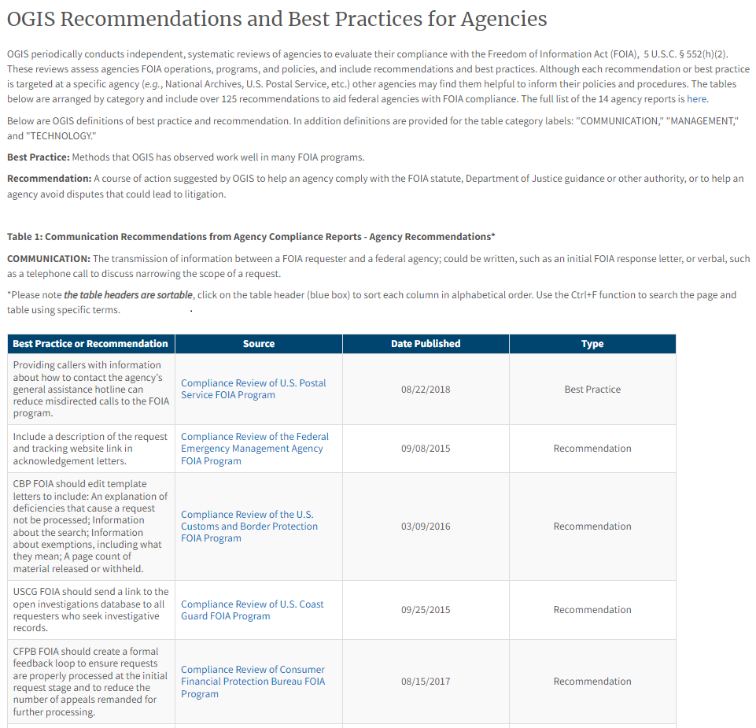
OGIS Recommendations & Best Practices
Nearly 180 from agency & issue assessments
Three categories:
  Management
  Technology
  Communication
Notes:
Slide 6 [Recommendations and Best Practices] - ALINA
OGIS has issued Nearly 180 recommendations in agency and issue assessments
Fall into categories of Communications, Management and Technology
Some very agency specific; others less so
Created bank in response to inquiries we sometimes get from FOIA professionals who ask what recommendations OGIS has made
Sortable and searchable
All available on our website!

Slide 7
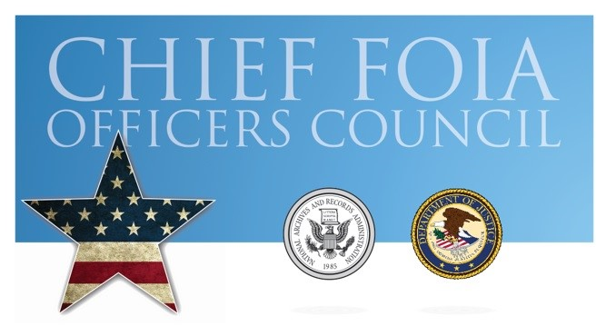
Notes:
Slide 7 [Chief FOIA Officers Council] - ALINA
OIP Director Bobby Talebian and I co-chair the Chief FOIA Officers Council, which Congress created with the passage of the 2016 FOIA Improvement Act.
Thanks to two different recommendations from the FOIA Advisory Committee, we created two active CFO Council Committees: The Technology Committee in 2020, and the Committee on Cross-Agency Collaboration and Innovation (COCACI) in 2022.
Membership has included FOIA professionals from both cabinet-level and independent agencies. The Technology Committee has been co-chaired by Eric Stein at the State Department and Michael Sarich at Veterans Affairs. And the COCACI has been co-chaired by Abi Mosheim at CPSC and Mike Bell at Department of Transportation.
There are some great opportunities for partnership and collaboration: I am happy to say that both Committees have proven to be a terrific opportunity for agency FOIA professionals to get involved and collaborate with many other agency colleagues across the federal government. Lots of connections have been formed and FOIA friendships have been forged!
I see a lot of opportunity for many of you here today to become involved with these two Committees and their working groups. Please check out the CFO Council web page accessible on FOIA.gov for more details - and let me know if you want to become involved!
Both Committees can benefit from an injection of fresh enthusiasm and desire for change, and there are lots of opportunities to contribute in very impactful ways!
I recently shared with Bobby Talebian that I am very proud that we have managed to bring so many folks together - talking to each other, sharing ideas. When I first entered the FOIA world years ago, I remember it being extremely siloed. Agencies really didn’t talk to each other or share ideas, and ran their FOIA programs relatively independently.
And speaking of collaboration …. several months ago, OGIS started a “FOIA Community of Interest” - initially it started out as a “support group” for FOIAXpress users - and refugees of FOIAonline, which EPA sunsetted in 2023. But it has morphed and grown in to at least 15 different agencies participating and it has become a forum for discussion of a variety of topics, including demos and discussions of case management systems, difficult requesters, and prolific requesters. I like to characterize it as a “safe space” for agency FOIA professionals to exchange ideas and information. We currently meet every other Tuesday from noon to 1 pm - and if you’re interested in joining us, please let me know and I’ll be happy to add you to the calendar invite.

Slide 8
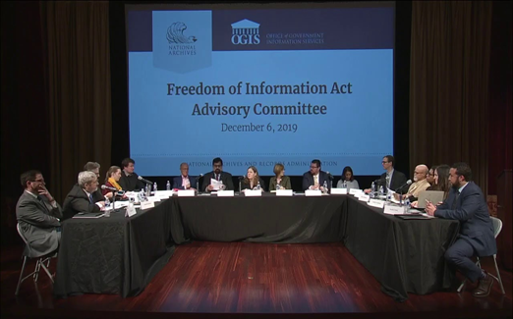
FOIA Advisory Committee
Dovetails with OGIS’s mandate to “identify procedures and methods for improving [FOIA] compliance.’’
Equal number of government and non-government members
67 recommendations total
New term starts September 9th
Register on Eventbrite or watch on the
NARA YouTube channel!
https://www.archives.gov/ogis/foia-advisory-committee/dashboard
Notes:
Slide 8 [FOIA Advisory Committee] - ALINA
The FOIA Advisory Committee is one way OGIS works to meet our mandate to “identify procedures and methods for improving FOIA compliance.
The National Archives established the FOIA Advisory Committee in 2014 to foster dialogue between the Administration and the requester community, solicit public comments, and develop consensus recommendations for improving FOIA administration and proactive disclosures.
The OGIS Director—me!—chairs the Committee and OGIS staff provide administrative and managerial support
Committee members, who are appointed by and report to the Archivist of the United States, include 10 FOIA professionals in government and 10 individuals from outside government that represent the requester community. The members are mandated with developing recommendations for improving the FOIA process
67 recommendations total; you can view them all in a dashboard which we have published on OGIS’s website
5 terms, with the 6th term starting in September. Our first meeting is in person at the National Archives Building on September 9th at 10am. If you would like to join us in person, please sign up via Evenbrite.
You can also live stream this upcoming meeting - and any of our committee meetings—on NARA’s YouTube channel.

Slide 9
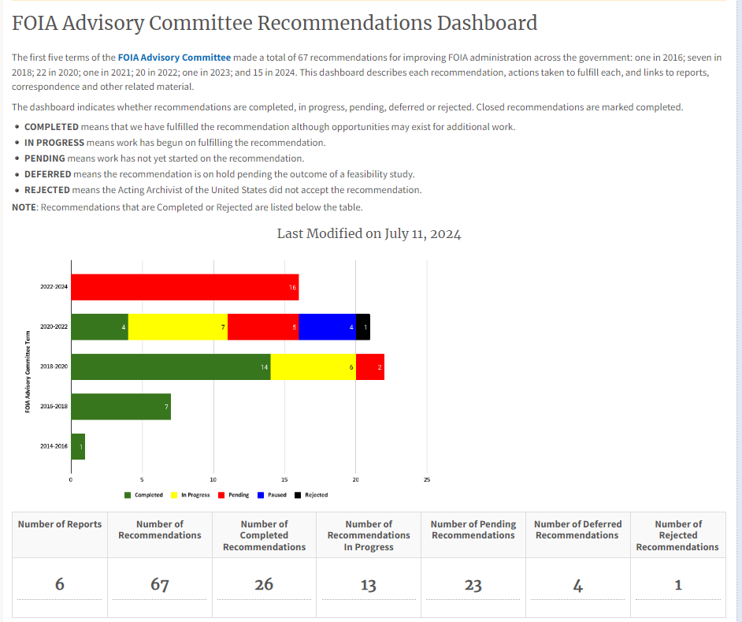
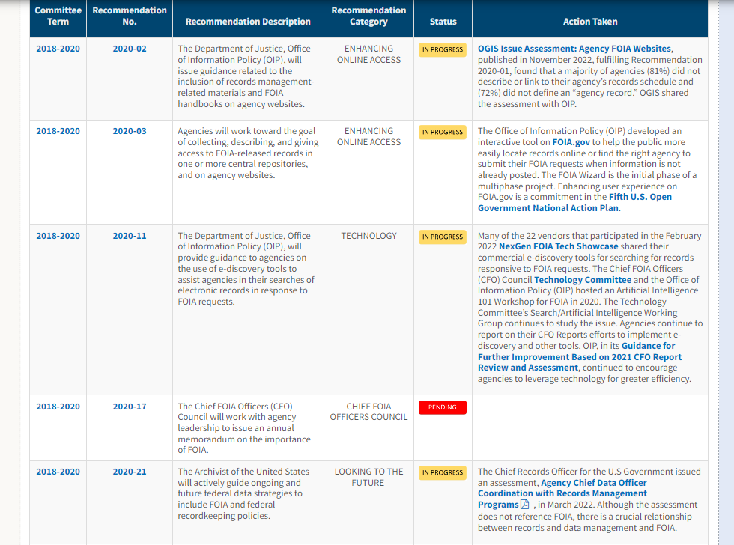
FOIA Advisory Committee Dashboard
Notes:
Slide 9 - ALINA:
We have created a terrific Recommendations Dashboard in order to keep track of the great work the Committee has done – there have been a total of 53 recommendations and a number of best practices that are discussed in the four reports of the prior terms.
We update the Dashboard periodically as we make progress on the recommendations - and as additional recommendations are passed.
We recently reshuffled the recommendations and moved the In-Progress and Pending recommendations to the top - and “Completed” and “Rejected” FOIA Advisory Committee Recommendations are accessible by clicking on separate radio buttons at the botom.

Slide 10

Resolving FOIA Disputes
Addressing questions and concerns about the FOIA process
Provides information through “shuttle diplomacy”
Increase understanding of positions and interests
Notes:
Slide 11 [Resolving FOIA Disputes] - JESSIE
OGIS’s mediation team does a lot of ombuds work, meeting the requester where they are in the FOIA process—which may start before they even file a FOIA request—and helping to guide them through the process by answering their questions and addressing any concerns.
And we will provide some common examples in just a minute.
Rather than engaging through face to face mediation processes—where the parties sit around a table to discuss the dispute—we engage more using shuttle diplomacy where we convey issues, concerns, and responses between the parties.
Because of the Administrative Dispute Resolution Act (ADRA) which requires a certain level of confidentiality, we do not pass to agencies any materials the requester provides, unless we have the requester’s express consent to do so.
Similarly, we keep communications we have with agencies confidential, and will respect your desire to not have certain information conveyed to the requester.
We have had some agencies say to us, “Look, we will tell you information about what was withheld so you understand, but we don’t want the requester to know this.” And that helps us, and we respect that!
It is also common practice for us to pass our letter or language we intend on using by the agency before it is finalized to ensure we have captured the agency’s position correctly. This gives the agency another opportunity to clarify their position.
Our goal is to increase understanding between the parties to reach a mutually agreeable solution.
It’s important to note that engaging with OGIS’s dispute resolution process is voluntary, and the agency is within its right to decline to participate.

Slide 11
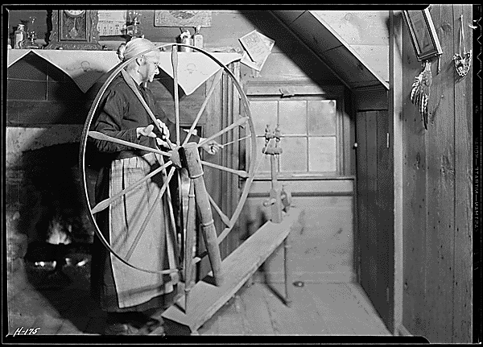
OGIS Does Not Ask Agencies To…
Prioritize one request before others
Review the use of exemptions post-appeal
Provide special treatment to one request or requester
Notes:
Slide 12 [Do NOT ask Agencies To] - JESSIE
To be super clear, when OGIS contacts an agency, we are not asking it to do anything that is against the FOIA statute, or their regulations. This means that we will not ask agencies to prioritize one request before others or finish processing a request by a certain deadline.
We do not intend to be, nor do we want to be a “squeaky wheel”.
We do not want an agency to provide special treatment to one request or requester, just because OGIS is reaching out.
We also do not ask agencies to re-do work post-appeal. We are not asking that agencies conduct a second (or third, or more) search, nor to re-review hundreds of pages with exemptions.
But we may ask how you interpreted the request, or what databases were searched, or about the balancing test or foreseeable harm that was considered.
We are looking for clarity on how the agency processed a FOIA so that we can explain it to the requester.

Slide 12




What Does OGIS’s Help Look Like?
I am looking for records about myself…
My request for a fee waiver was denied…
The agency withheld information from my records…
I haven’t received a response to my FOIA request…
Notes:
Slide 13 [What Does OGIS’s Help Looks Like] - JESSIE
Here are some of the concerns requesters bring to us:
Requesters will contact us saying, “I am looking for my immigration records…” or “I am looking for service records…”
OGIS will explain they need to make a request for the records sought, and we will provide reference materials that can help.
We also utilize—and pass to requesters—the reference materials agencies post to their websites to provide directions. So whatever influence you have over your agency’s website content, please look it over it to help the requesters, yourself, and also OGIS!
Even though OGIS cannot assist with requests made under the Privacy Act (the substance of requests, if you will), we will try to help with process issues. Also, not all requests for first party records are processed under the Privacy Act, or they are processed under both statutes, so we do have a role with those requests.
The FOIA process can be very confusing, even for seasoned requesters. And it may not be obvious that OGIS is an independent office, so many requesters come to OGIS saying, “I am writing to appeal the agency’s decision to withhold records.”
We explain that we are independent and neutral, the importance of an administrative appeal and point them to the next step.
And sometimes that next step is redirecting them to another agency that might have the records they need.
We may hear, “The agency denied my fee waiver request, and told me I owe fees for search and duplication, but I don’t know what that means,” or agencies may tell us “We asked the requester about the request to determine the fee category, and haven’t received a response.”
We can explain to requesters what fee categories are, why they are important, and the difference between fee categories and fee waivers.
We frequently hear from requesters: “I asked for records about myself and they withheld information from *my* records.”
We explain how agencies (and courts!) apply Exemption 6 (and Exemption 7(C)), and try to simplify the agency’s responsibility to conduct the balancing test.
This isn’t a negative reflection of agency’s response—agency responses often do have this information in it. It just might have a little too much legal information for a requester to understand, but more importantly if OGIS can simplify and explain this, we are validating the agency’s response and passively saying “the agency hasn’t done anything wrong here.”
Many requesters contact us saying something along the lines of, “I submitted a FOIA request 3 months ago, but I haven’t received a response to my FOIA.”
We encourage the requester to contact the agency for an EDC, and when appropriate, suggest they discuss the request to to reduce the scope and possibly get into a faster processing queue.

Slide 13

Customer Experience and Service
FOIA Website: Is the information comprehensive and accurate?
Correspondence: Do letters use plain language? Are they accurate and comprehensive?
Phone Lines: Are they functional and monitored?
Email: Are email addresses published and monitored?
Contact Information: Is it clear? Is FOIA.gov updated?
Notes:
Slide 14 [Customer Experience and Service] - ALINA
We have seen that as agencies get more and more incoming requests and backlogs are generally growing, that agencies have mandates to clear the backlog. A (hopefully, unintended) consequence to this is that customer service becomes a less or a non-existent priority for agencies.
But we would say that especially with growing backlogs, customer experience and customer service is even more important. We encourage you to consider the requester in all aspects in which the requester is engaging with the agency.
Customer experience refers to the whole customer journey and beyond, from the moment they look for information on how to file a FOIA to resolution of the FOIA request.
Customer service is about assisting the customer with a particular need in a specific circumstance.
[Discuss OGIS’s experience with customer experience journey mapping.]
This slide has some of the avenues you can provide good customer service.
First, look critically at the information on your website: how clearly written and presented is the website. Can a requester find and easily search your Reading Library to see if the records they want are already released? Does the website explain the FOIA process, requirements for submitting a perfected request, and contact information for the agency’s FOIA office?
Is OGIS’s information on there (and if it is, please ensure our fax number has been removed!)
Similarly, are letters written in plain language? Is the information in the letter accurate, does it convey all of the information the requester needs to understand where they are in the process, next steps and how to communicate if they have a question?
Are phone lines and emails monitored? Does your component have a mechanism to respond to phone calls, voicemail messages, and emails? Is your component responding to inquiries in a timely and reasonable manner?
Is contact information for FPLs, processing staff, or other FOIA Requester Service Centers complete and updated on FOIA.gov?
Did you know it was the agency’s responsibility to updated information of FOIA.gov. If you need help with that, contact DOJ OIP!

Slide 14

Communication is Key
Written Communications:
Scope of request
Returning required documentation
Clear and accurate follow up contacts
Minimal canned or legal language
Verbal Communications:
Consider the requester’s perspective
Narrowing and prioritizing request
Follow up in writing
Notes:
Slide 15 [Communication] - JESSIE
It’s commonly said that the key to any good relationship is communication. This is true for relationships between FOIA processing staff and requesters.
Really good communication can help lift the veil of this mysterious FOIA process. They submit their request, it goes into this process that they don’t know or understand—or sometimes a black hole never to be seen again—and they may not get all of the information they requested or expected. But communicating with requesters allows them to have even a little insight into the process which makes them have ownership and then they have a vested interest in having the FOIA (process) be successful.
And there are lots of opportunities to communicate with requesters, passively and actively!
Written correspondence is important, and protects the agency, but it’s not the only way to communicate with requesters. Sometimes having conversations on the phone is much more productive—and quicker.
In written responses:
We recommend that agencies include at least a paraphrasing of the subject of the request. This can help the requester feel understood, and that the agency is clear about the records they are trying to locate.
As much as possible, we encourage including information about the search parameters, the quantity of responsive records (e.g.: x-number of pages or documents, or 2 terabytes of data), and other metrics (such as, “5 pages are withheld pursuant to this FOIA exemption.”)
Remember, requesters cannot narrow or prioritize their request, if they have no idea what was found, or how much. Requesters need information about the search and responsive records to make informed decisions, but they cannot narrow or prioritize a request if they are unaware that is an option. It’s important to include *who and how* requesters should contact for these conversations.
Discussions about the scope of a request may be easier in real time. After laying out the world of the request consider having a phone conversation which may cut down on some of the aggravation of having a back and forth through email. And if narrowing isn’t possible or an option, you can also talk about prioritizing requests for rolling releases.
Again, be clear about how requesters can provide information needed to process a request. If you need more information about the FOIA request to determine fee category; or you need more information to structure the search; or authorization/ proof of death to process the request, be clear about how you want the requester to provide that information.
Providing a phone number and email address—even to a monitored group box where submissions are handled in a timely manner—is incredibly important. Include information of a particular subject line is needed, or do they need to send it postal mail? Provide clear and explicit instructions of what the agency needs, and how the requester can provide it for the requester to follow.
Make sure that you provide the requester with their fee category when you deny their fee waiver. This can often prevent an appeal.
We would also suggest agencies look at the aesthetic of the letter. Is information on how to contact the FPL, appeal, and how to contact OGIS squished together. As we talked about earlier, we receive a lot of mail from requesters who think we are the agency and get frustrated when we have to re-direct them. Responses can use visual clues to separate those entities, so they do not end up contacting the wrong party.
If you think about this from the requester’s perspective: it takes their time and energy to contact the FPL or OGIS when they are trying to submit an appeal, wait for the FPL or OGIS to respond, and then take more time and energy to try again.
This adds to what can already feel like a convoluted, unnecessarily elaborate bureaucratic process (increasing negative and frustrating emotions from the requester).
We would encourage agencies to consider the perspective of the requester and what the requester may feel is “information overload”.
We also see a lot of requesters are confused by agency responses when there is extraneous canned language that has no relevance to their request.
Similarly, responses that have an abundance of legalese language can have negative reactions when the requester cannot understand the message.
Going back to real-time conversations—which we cannot stress enough, is sometimes the best way to communicate—before starting a conversation, consider the type of requester you are reaching out to. That may help to gauge their level of knowledge and understanding of the FOIA process and your agency’s records.
Are they a journalist or first party requester? Are they from an advocacy organization? Commercial requester?
Also consider where they are in the FOIA process and therefore what are the opportunities for using communication to improve the FOIA outcome.
We highly recommend always following up verbal communications with written to summarize conversation and confirm decisions. This gives both parties an opportunity to clarify any miscommunications!

Slide 15
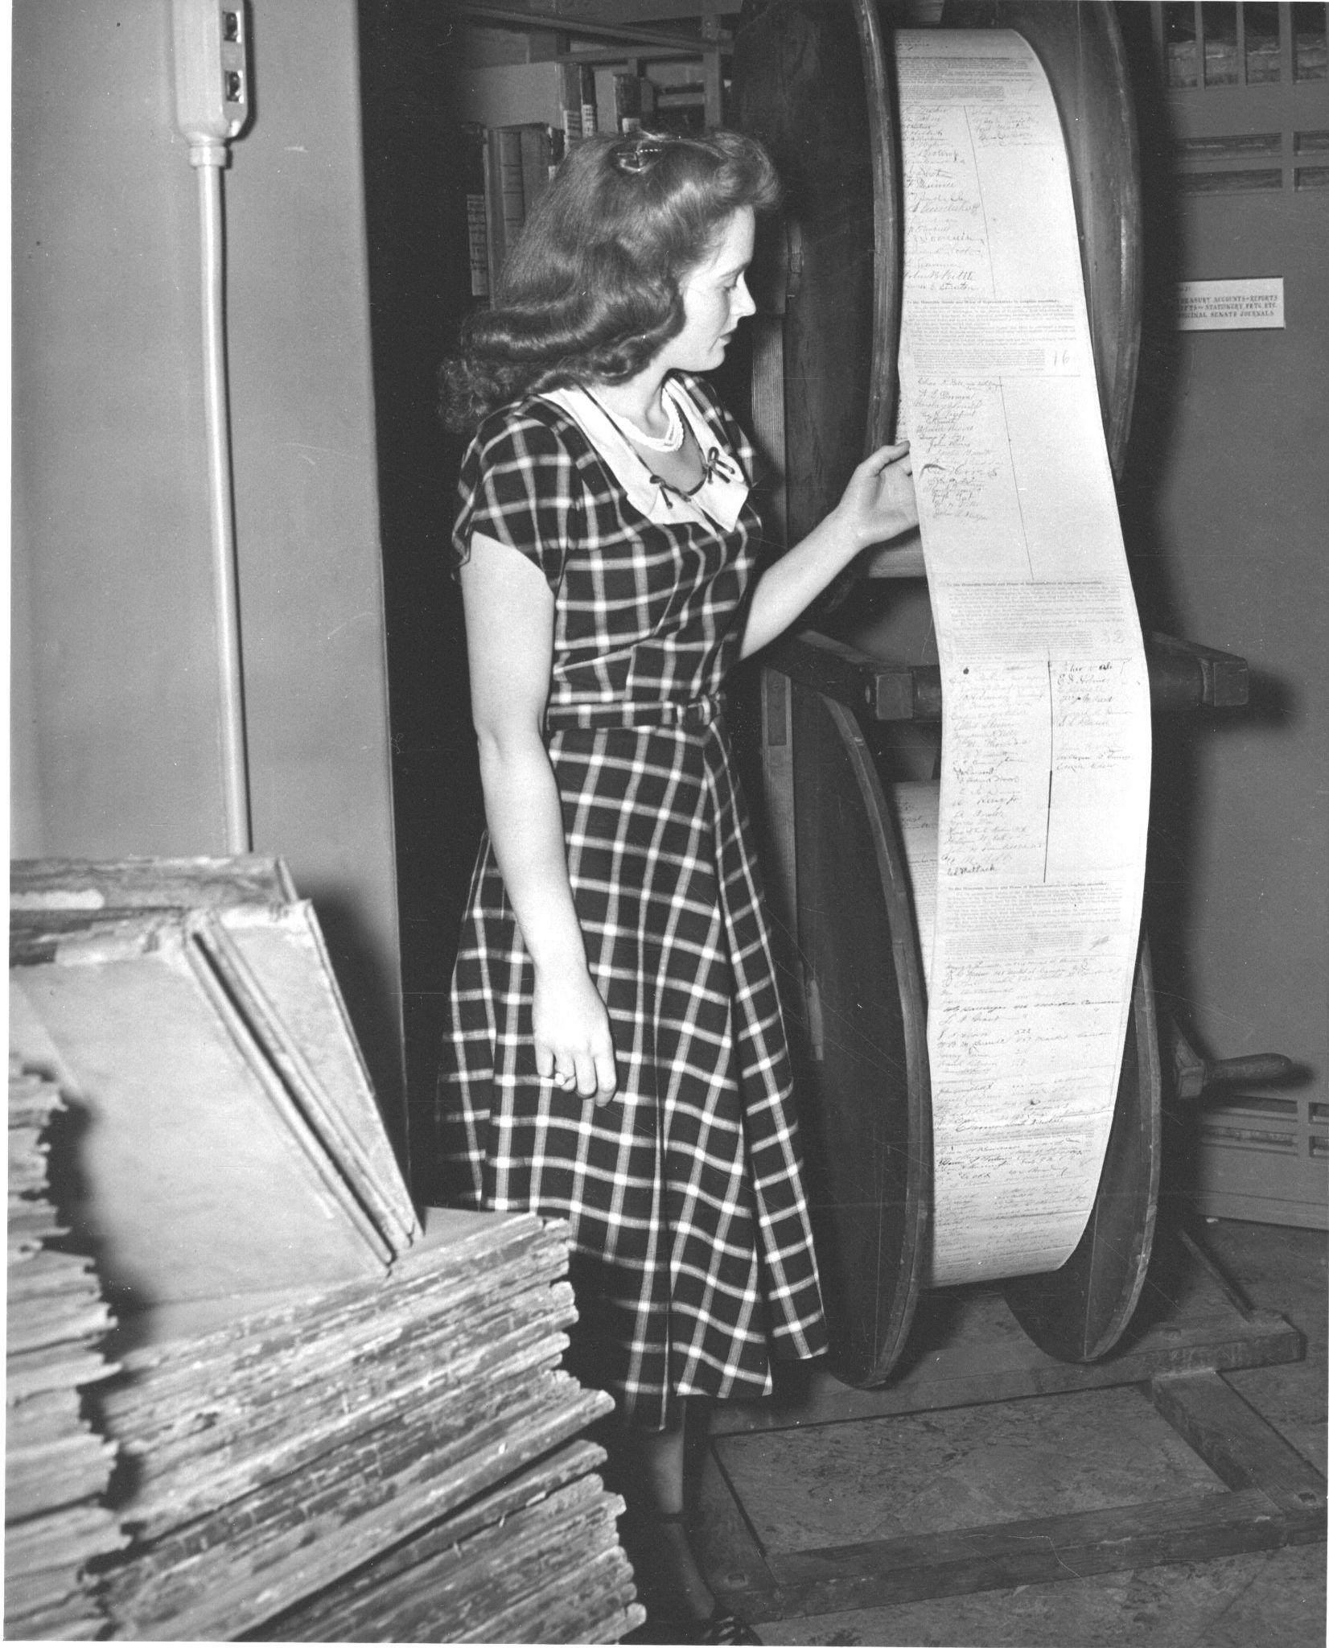
What About Agencies?
Negotiation Skills Training
Conflict Coaching
Soundboarding
Letter/ Language Review
Notes:
Slide 19 [Agency Resources] - JESSIE
OGIS offers a variety of training including the Negotiation Skills Training, which some of you may have gotten a primer from me and our colleague earlier this year, or your component may have had the full training experience.
In our Negotiation Skills training, we discuss barriers to negotiation; principled negotiation which is more effective than positional bargaining; uncovering and untangling positions vs. interests; reframing; communication that works; and tips and best practices for negotiation.
If any of these concepts are unfamiliar, or you want a refresher, let us know!
Our current training is about two and a half hours with a small break, is interactive, and can be done virtually, or—we haven’t done this yet since the pandemic—but also in person.
We are pretty booked up for the rest of the fiscal year, but happy to look at 2025 for dates!
We are also happy to do focused conflict coaching, or even just soundboarding if there is a particularly challenging request or requester.
We also love the opportunity to provide feedback on letters and standard language. This is done in conjunction with OGIS’s Compliance team.

Slide 16




Keep in Touch!
www.archives.gov/ogis
ogis@nara.gov
@FOIA_ombuds
foia.blogs.archives.gov
Notes:
Slide 20 [OGIS Contact Info] - JESSIE
Bookmark our website
Email us: ogis@nara.gov is a monitored email box. Your message will not go unread!
Read and subscribe to our blog The FOIA Ombudsman. All of our events, including the meetings of the FOIA Advisory Committee and the Chief FOIA Officers Council, are previewed here.
Use this QR code to type in your email to subscribe to our blog
Follow us on the platform formerly known as Twitter!
And now … questions?

