Slide 1
Personally Identifiable Information Processing And
Transparency
Justin May
OCIO | CSD | RMC
22 Oct 24
CUI//ISVI//FEDCON

Slide 2
OUTLINE
PURPOSE
DOC ECP
NOAA ITSM
NIST SP 800-53r5 PT Family
SPCMv8.2 PT Family
CSAM Privacy
QUESTIONS
CUI//ISVI//FEDCON

Slide 3
PURPOSE
Describe and discuss required security controls as mandated through FISMA for the PT Family of security controls.
CUI//ISVI//FEDCON
Notes:
Executive Order on Improving the Nation’s Cybersecurity
https://www.whitehouse.gov/briefing-room/presidential-actions/2021/05/12/executive-order-on-improving-the-nations-cybersecurity/
“The United States faces persistent and increasingly sophisticated malicious cyber campaigns that threaten the public sector, the private sector, and ultimately the American people’s security and privacy. The Federal Government must improve its efforts to identify, deter, protect against, detect, and respond to these actions and actors. The Federal Government must also carefully examine what occurred during any major cyber incident and apply lessons learned. But cybersecurity requires more than government action. Protecting our Nation from malicious cyber actors requires the Federal Government to partner with the private sector. The private sector must adapt to the continuously changing threat environment, ensure its products are built and operate securely, and partner with the Federal Government to foster a more secure cyberspace.”

Slide 4
DOC ECP
In coordination with the Office of Privacy and Open Government (OPOG), Bureaus must complete a Privacy Threshold Assessment (PTA), Privacy Impact Assessment (PIA), and System of Record Notice (SORN), as applicable for information systems that collect, use, store, and/or transmit Personally Identifiable Information (PII), in accordance with OMB M-03-22.
CUI//ISVI//FEDCON
Notes:
Executive Order on Improving the Nation’s Cybersecurity
https://www.whitehouse.gov/briefing-room/presidential-actions/2021/05/12/executive-order-on-improving-the-nations-cybersecurity/
“The United States faces persistent and increasingly sophisticated malicious cyber campaigns that threaten the public sector, the private sector, and ultimately the American people’s security and privacy. The Federal Government must improve its efforts to identify, deter, protect against, detect, and respond to these actions and actors. The Federal Government must also carefully examine what occurred during any major cyber incident and apply lessons learned. But cybersecurity requires more than government action. Protecting our Nation from malicious cyber actors requires the Federal Government to partner with the private sector. The private sector must adapt to the continuously changing threat environment, ensure its products are built and operate securely, and partner with the Federal Government to foster a more secure cyberspace.”

Slide 5
NOAA ITSM-1
3.6 NOAA Privacy Act Officer / Freedom of Information Act (FOIA) Officer
Implementation Level - NOAA CIO
The NOAA Bureau Chief Privacy Officer (BCPO) works with the DOC Office of Privacy and Open Government (OPOG) and the Director of OPOG for the development and maintenance of privacy policies, procedures, and guidance essential to safeguarding the collection, access, use, dissemination, and storage of personally identifiable information (PII) and Privacy Act information in accordance with the Privacy Act of 1974, the E-Government Act of 2002, the Federal Information Security Modernization Act (FISMA), and policy and guidance issued by the President and the Office of Management and Budget (OMB), and for the conduct of Privacy Impact Assessments on Information Technology that collects, maintains, or disseminates information in an identifiable form.
In addition to responsibilities in NOAA FOIA Office below, NOAA FOIA Officer:
Approves or denies fee waiver and expedited processing requests.
Acts as Denial Official, as listed in Appendix B of 15 CFR Part 4
NOAA FOIA Officer will:
Review and update FOIA policies, procedures, and guidance in coordination with the Department of Commerce (DOC) FOIA Office and NOAA Office of General Counsel (NOAA GC).
Offer guidance, advice, and training to NOAA managers, program personnel, and FOIA Liaisons who respond to FOIA requests and provide basic training on NOAA FOIA procedures to employees.
Prepare and submit the NOAA contribution of the FOIA Annual Report to the Department of Justice and Chief FOIA Officer report, and coordinate the submission of all other FOIA reports requested of NOAA.
Maintain the NOAA FOIA home page.
Retain copies of all FOIA requests and files in FOIAonline unless there is a documented strong business need to maintain outside of the web-based tool. Original copies of responsive records, whether released or not, are kept by the FOIA Staff Office/Line Office Liaison or Action Office.
Review all FOIA requests received by NOAA, including referrals from DOC and other federal agencies, and assign them to the appropriate FOIA Liaison whose office may have records responsive to the request and, when appropriate, suggest adding a task to additional office(s) at the time of assignment.
Serve as agency lead for responding to all FOIA requests referred to NOAA from DOC.
Maintain a list of all NOAA appeals and work with FOIA Liaisons to facilitate the appeals process.
Function as the primary liaison between NOAA and DOC in resolving any FOIA issues.
Read each FOIA response to review metadata for completeness and mark it as closed in FOIAonline.

Slide 6
NOAA ITSM-2
4.1.15 Personally Identifiable Information Processing and Transparency (PT)
In coordination with OPOG, NOAA Chief Privacy Officer must complete a Privacy Threshold Assessment (PTA), Privacy Impact Assessment (PIA), and System of Record Notice (SORN), as applicable for information systems that collect, use, store, and/or transmit Personally Identifiable Information (PII).
NOAA Chief Privacy Officer in coordination with FISMA systems owners
Identifies and documents the use of PII within the information system;
Restricts access to and use of PII to only authorized personnel;
Monitors changes in processing PII within the information system;
Implements security and privacy controls to protect PII; and
Publishes privacy notices which authorizes the processing of PII.
To reduce the burden on NOAA FISMA systems assessment and authorization activities, where appropriate, CSD will coordinate with responsible equities to implement, assess, and manage applicable PT controls as a NCCM allowing individual FISMA systems to inherit.

Slide 7
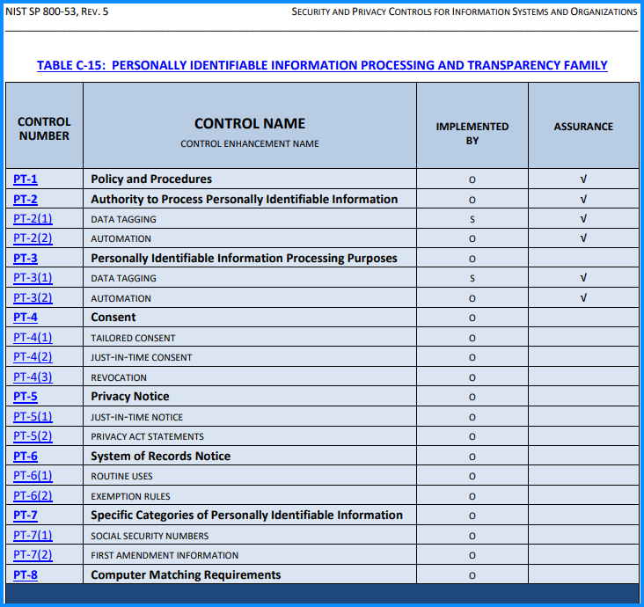
NIST SP 800-53r5 PT Family
• A control or control enhancement that has been withdrawn from the control catalog is
indicated by a “W” and an explanation of the control or control enhancement disposition in light gray text.
• A control or control enhancement that is typically implemented by an information system through technical means is indicated by an “S” in the implemented by column.
• A control or control enhancement that is typically implemented by an organization (i.e., by an individual through nontechnical means) is indicated by an “O” in the implemented by column.
• A control or control enhancement that can be implemented by an organization, a system, or a combination of the two is indicated by an “O/S.”
• A control or control enhancement marked with a “√” in the assurance column indicates the control or control enhancement contributes to the grounds for confidence that a security or privacy claim has been or will be achieved.

Slide 8
SPCMv8.2 PT Security Control Family-1
Control Family: | PT
Control | Security Control Name | Control Language with parameters inline | Implementation Responsibility | Privacy (P)
PT-01 | Policy and Procedures | a. Develop, document, and disseminate to [Authorizing Official (AO), System Owner (SO), Information System Security Officer (ISSO), Information Technology Security Officer (ITSO) Senior Agency Official for Privacy (SAOP), and NOAA Chief Privacy Officer (CPO)]: 1. [Organizational-level] personally identifiable information processing and transparency policy that: (a) Addresses purpose, scope, roles, responsibilities, management commitment, coordination among organizational entities, and compliance; and (b) Is consistent with applicable laws, executive orders, directives, regulations, policies, standards, and guidelines; and 2. Procedures to facilitate the implementation of the personally identifiable information processing and transparency policy and the associated personally identifiable information processing and transparency controls; b. Designate an [Senior Agency Official for Privacy and Director of DOC Office of Privacy and Open Government; NOAA Chief Privacy Officer and designated officials as defined by the NOAA Chief Privacy Officer] to manage the development, documentation, and dissemination of the personally identifiable information processing and transparency policy and procedures; and c. Review and update the current personally identifiable information processing and transparency: 1. Policy [annually] and following [assessment or audit findings, security incidents or breaches, or changes in laws, executive orders, directives, regulations, policies, standards, and guidelines]; and 2. Procedures [annually] and following [assessment or audit findings, security incidents or breaches, or changes in laws, executive orders, directives, regulations, policies, standards, and guidelines]. | Common | X
PT-02 | Authority to Process Personally Identifiable Information | a. Determine and document the [IT Privacy Policy and U.S. Department of Commerce Office of Privacy and Open Government, authorized by the laws and regulations documented here: https://www.osec.doc.gov/opog/privacy/laws_and_regs.html IT Privacy Policy, Office of Privacy and Open Government, U.S. Department of Commerce] that permits the [processing, in accordance with the DOC OPOG PTA/PIA requirements] of personally identifiable information; and b. Restrict the [processing, in accordance with the DOC OPOG PTA/PIA requirements] of personally identifiable information to only that which is authorized. | Hybrid | X

Slide 9
SPCMv8.2 PT Security Control Family-2
Control Family: | PT
Control | Security Control Name | Control Language with parameters inline | Implementation Responsibility | Privacy (P)
PT-03 | Personally Identifiable Information Processing Purposes | a. Identify and document the [purpose(s), defined within the DOC OPOG PTA/PIA requirements] for processing personally identifiable information; b. Describe the purpose(s) in the public privacy notices and policies of the organization; c. Restrict the [processing, in accordance with the DOC OPOG PTA/PIA requirements] of personally identifiable information to only that which is compatible with the identified purpose(s); and d. Monitor changes in processing personally identifiable information and implement [storage, use, or sharing within NOAA] to ensure that any changes are made in accordance with [the DOC Program Management Plan, that updates would be required for the PTA/PIA]. | Hybrid | X
PT-04 | Consent | Implement [Notice of consent requiring acceptance or denial] for individuals to consent to the processing of their personally identifiable information prior to its collection that facilitate individuals’ informed decision-making. | Hybrid | X
PT-05 | Privacy Notice | Provide notice to individuals about the processing of personally identifiable information that: a. Is available to individuals upon first interacting with an organization, and subsequently at [every time the individual accesses the system]; b. Is clear and easy-to-understand, expressing information about personally identifiable information processing in plain language; c. Identifies the authority that authorizes the processing of personally identifiable information; d. Identifies the purposes for which personally identifiable information is to be processed; and e. Includes [System-defined Routine Use and Disclosure]. | Hybrid | X
PT-05(2) | Privacy Act Statements | Include Privacy Act statements on forms that collect information that will be maintained in a Privacy Act system of records, or provide Privacy Act statements on separate forms that can be retained by individuals. | Hybrid | X

Slide 10
SPCMv8.2 PT Security Control Family-3
Control Family: | PT
Control | Security Control Name | Control Language with parameters inline | Implementation Responsibility | Privacy (P)
PT-06 | System of Records Notice | For systems that process information that will be maintained in a Privacy Act system of records: a. Draft system of records notices in accordance with OMB guidance and submit new and significantly modified system of records notices to the OMB and appropriate congressional committees for advance review; b. Publish system of records notices in the Federal Register; and c. Keep system of records notices accurate, up-to-date, and scoped in accordance with policy. | Common | X
PT-06(1) | Routine Uses | Review all routine uses published in the system of records notice at [annually or if there are significant changes to the system boundary, system architecture, or system information types] to ensure continued accuracy, and to ensure that routine uses continue to be compatible with the purpose for which the information was collected. | Common | X
PT-06(2) | Exemption Rules | Review all Privacy Act exemptions claimed for the system of records at [a minimum, annually or if there are significant changes to the system boundary, system architecture, or system information types] to ensure they remain appropriate and necessary in accordance with law, that they have been promulgated as regulations, and that they are accurately described in the system of records notice. | Common | X
PT-07 | Specific Categories of Personally Identifiable Information | Apply [System-defined processing conditions, consistent with FIPS 140-2 encryption methodology.] for specific categories of personally identifiable information. | Common | X

Slide 11
SPCMv8.2 PT Security Control Family-4
Control Family: | PT
Control | Security Control Name | Control Language with parameters inline | Implementation Responsibility | Privacy (P)
PT-07(1) | Social Security Numbers | When a system processes Social Security numbers: (a) Eliminate unnecessary collection, maintenance, and use of Social Security numbers, and explore alternatives to their use as a personal identifier; (b) Do not deny any individual any right, benefit, or privilege provided by law because of such individual’s refusal to disclose his or her Social Security number; and (c) Inform any individual who is asked to disclose his or her Social Security number whether that disclosure is mandatory or voluntary, by what statutory or other authority such number is solicited, and what uses will be made of it. | Common | X
PT-07(2) | First Amendment Information | Prohibit the processing of information describing how any individual exercises rights guaranteed by the First Amendment unless expressly authorized by statute or by the individual or unless pertinent to and within the scope of an authorized law enforcement activity. | Common | X
PT-08 | Computer Matching Requirements | When a system or organization processes information for the purpose of conducting a matching program: a. Obtain approval from the Data Integrity Board to conduct the matching program; b. Develop and enter into a computer matching agreement; c. Publish a matching notice in the Federal Register; d. Independently verify the information produced by the matching program before taking adverse action against an individual, if required; and e. Provide individuals with notice and an opportunity to contest the findings before taking adverse action against an individual. | Hybrid | X

Slide 12
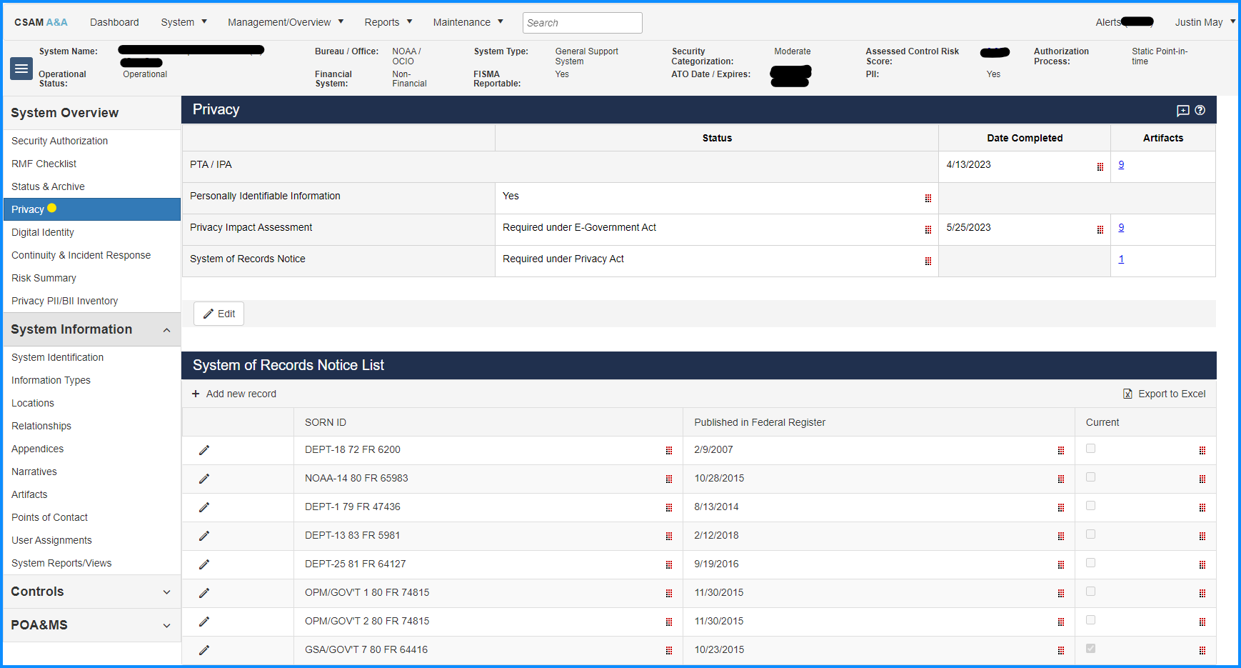
CSAM: Privacy Related-1

Slide 13
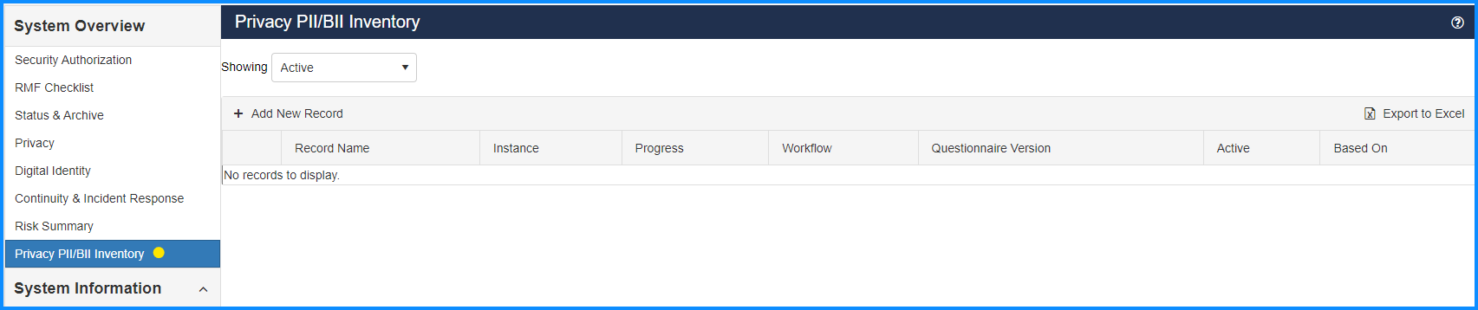
CSAM: Privacy Related-2

Slide 14
QUESTIONS
If you think of a question after this briefing is over, please reach out to us at noaa.rmc@noaa.gov or justin.may@noaa.gov
THANK YOU
CUI//ISVI//FEDCON
Notes:
Note for Mark: Risk Assessment Tools: https://www.nist.gov/itl/applied-cybersecurity/privacy-engineering/collaboration-space/focus-areas/risk-assessment/tools

