Slide 1
End of FY Metrics
Mark Graff, NOAA Bureau Chief Privacy Officer (BCPO), OCIO/NEDD
October 23, 2024

Slide 2
Course Outline
Backlog Reduction
Remaining Pending Cases
New Guidance re: Device Turn In
Line Office Breakdown
Questions

Slide 3

Backlog Reduction
NOAA reduced the backlog to a historic low of 54. NOAA has never had this low of a backlog in the last 10 years of maintained backlog metrics. The current backlog represents a significant 36% reduction from the prior Fiscal Year.

Slide 4
Backlog Reduction
This reduction also far exceeds the backlog reduction goal established by DOJ of a 10% decrease. Additionally, NOAA’s backlog reduction is even more pronounced against the backlog high at the time of the FOIAXpress System Transition.

Slide 5
Backlog Reduction
NOAA’s highest backlog during the Fiscal Year peaked at 156 after transitioning from FOIAOnline to FOIAXpress. The drop to 54 backlogged cases represents a 65% reduction overall from peak to trough.

Slide 6
Backlog Reduction
NOAA’s highest backlog during the Fiscal Year peaked at 156 after transitioning from FOIAOnline to FOIAXpress. The drop to 54 backlogged cases represents a 65% reduction overall from peak to trough.

Slide 7
Remaining Pending Cases
NOAA received a total of 870 FOIA requests during FY24. This is a 41% increase over the 616 FOIA requests NOAA received in FY23.

Slide 8
New Guidance on Device Turn-In
On January 8, 2024, NOAA re-issued it’s records retention reminder.
Reiterates the requirement that all Federal Records be transferred from mobile phones, laptops, tablets, or other issued devices, to repositories governed by a records retention schedule.
Notes:
https://www.noaa.gov/organization/information-technology/policy-oversight

Slide 9

New Guidance on Device Turn-In
The Guidance also includes a requirement that—at the time of device turn-in—employees certify that the employee has complied with NOAA Policy for the handling of Federal Records in their possession.
Notes:
https://www.noaa.gov/organization/information-technology/policy-oversight

Slide 10
New Guidance on Device Turn-In
This avoids the kind of scenario that NOAA encountered in the DSFU v. NOAA litigation, where the Plaintiff challenged NOAA’s search adequacy by indicating that a search had not been conducted of a retired employee’s cell phone prior to retirement.
Notes:
https://www.noaa.gov/organization/information-technology/policy-oversight

Slide 11
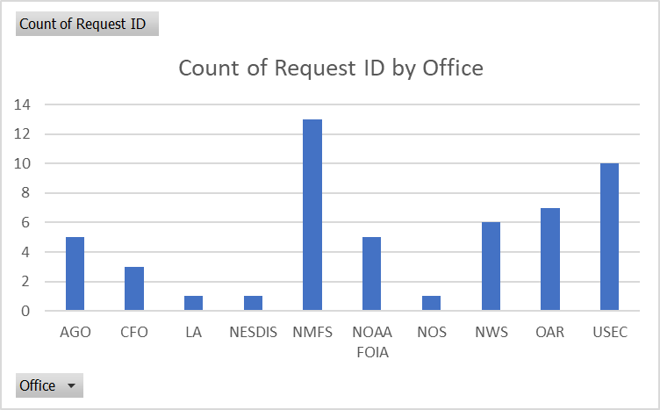
Line Office Breakdown
Each of the Line Offices put forth a tremendous effort, with backlogs dropping within virtually every Staff and Line Office. The final backlogs, by Office, are as follows:

Slide 12
Line Office Breakdown
NOAA had significant success in reducing the backlog, but recently has had an extremely high volume of incoming requests leading up to the end of the FY. As such, NOAA currently has 227 pending requests.

Slide 13
Line Office Breakdown
By way of comparison, NOAA had 133 open requests at the same time last year. As such, NOAA is facing a 71% pending request spike year over year. That underscores the accomplishment it was to reduce the backlog, despite the significant incoming request volume.

Slide 14
Line Office Breakdown
As a reminder, the backlog reduction efforts also have a direct correlation to the Staff and Line Office contribution requirements to the CIO Direct Bill for FOIA. The percentage of NOAA’s backlog at the end of the fiscal year attributable to that Office is the percentage of the Direct Bill contribution required from that Office. This year, each backlog case equates to approximately $20,370 in Direct Bill FOIA contribution requirements.

Slide 15
QUESTIONS?
QUESTIONS?

