Slide 1
Update on NOAA Data Initiatives
NOAA FOIA Roundtable
October 22, 2024
Tony LaVoi, NOAA Chief Data Officer (CDO), Data Governance Committee (DGC) Chair

Slide 2
FY24 FOIA Performance!
Detailed presentation on FOIA Metrics during day two from Mark
Record setting performance in total FOIA requests received, processed, and backlog status as of the year-end AG reporting
Only possible due to the dedication and commitment of the FOIA Liaison Network
Model approach for other DOC bureaus - asking for your assistance
Thank you to each of you for your efforts!

Slide 3
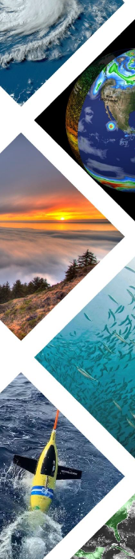
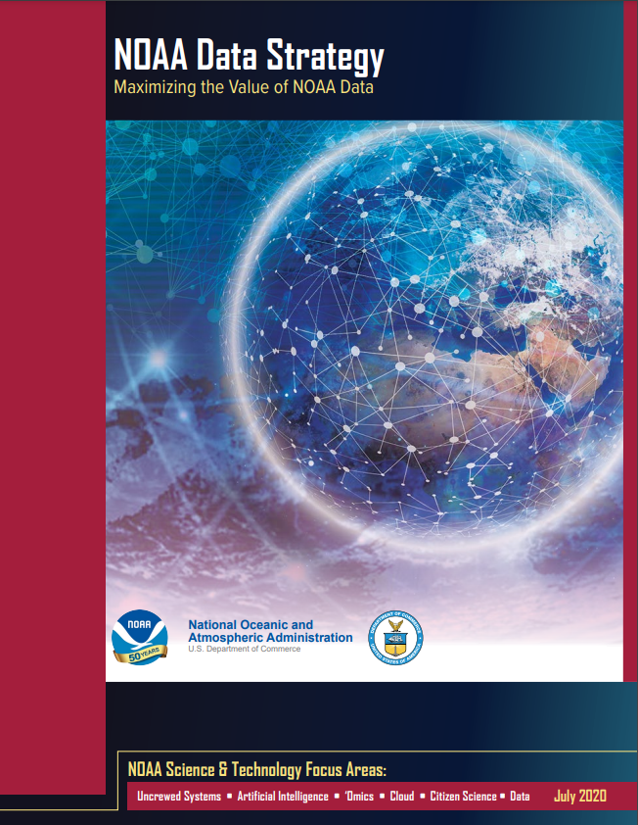
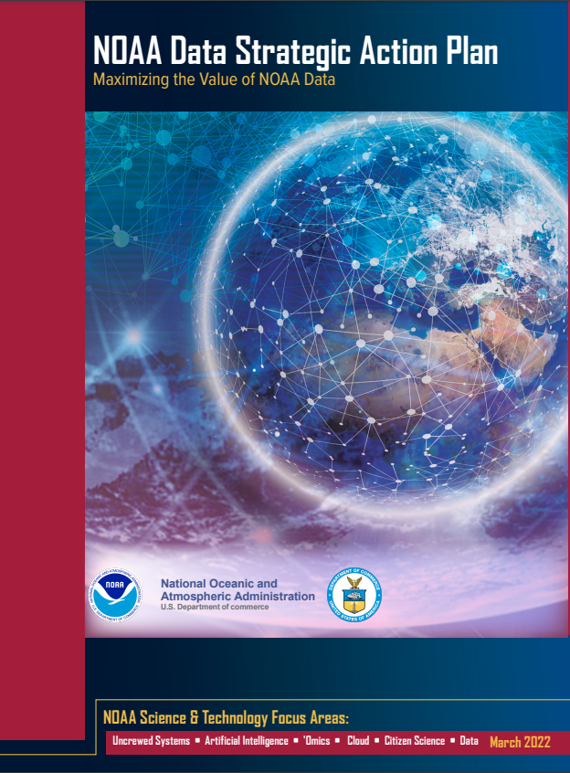
State of NOAA Data
Active and Growing NOAA Data Community
Commitment to Open Data and Open Science
Focus on Equitable & Inclusive Access
Quality and Transparency
Mix of Strategy & Implementation
Released in 2020
Released in 2022
Notes:
Analysis ready - AI ready data - standards
Enabling science

Slide 4







Data Governance Committee (DGC) Status
Assistant Chief Data Officers (ACDO)
  NESDIS - Jessica Morgan (permanent)
  NMFS - Nori Shoji (permanent)
  NOS - Megan Cromwell (permanent)
  OAR - Amy Biggs (permanent)
  NWS - Maria Sims (acting)
  OMAO - Vacant
DGC Sub-Structure
  Working Groups (6): Geographic Information Services (GIS); Enterprise Metadata; Enterprise Data Management Workshop (EDMW); Data Communications; Open Geospatial Consortium (OGC); Public Access to Research Results (PARR)
  Task Teams (2): Commercial Data Buys; Non-Environ. Data
  Completed (8): DOI TT; Data Dissemination TT; Catalog WG; Licensing TT; Policy/Handbook TT; Standards TT; Handbook Metrics TT
NMFS
ACDO
NOS
ACDO
NESDIS
ACDO
NOAA
Data Governance Committee
(DGC)
NWS
ACDO
NOAA
CDO
OAR
ACDO
SO/CO
TBD
OMAO
ACDO
NOAA CDO is a member of the CIO Council, NOAA Observing Systems Council (NOSC), NOAA Science Council, and NOAA AI Executive Committee
Notes:
DGC as Change Agents

Slide 5
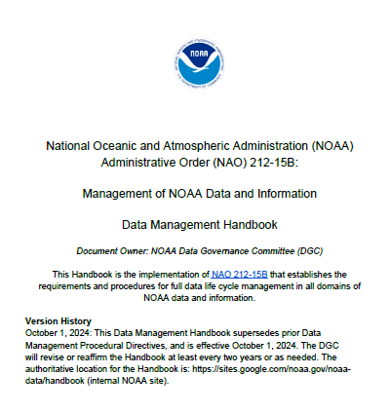
NOAA Data Management Handbook
Background
  Creation of a single data management handbook to cover the entire organization was a challenge given NOAA’s diverse missions, data, cultures, resources, and technologies
  NAO 212-15B (Management of NOAA Data and Information) gives authority to the Handbook
Timeline
  Core development and review FY22-24
  Provisional Version 1.0 released in mid-July for final comments
  Official release - October 1, 2024

Slide 6
NOAA Data Strategy Status
Goal | Objectives (1 - 5) |  |  |  |  | Accomplishments | Gaps/To-Do
Leadership | 1.1 | 1.2 | 1.3 | n/a | n/a | Chartering of the DGC and associated WG and TT; Data Management Handbook; PARR and SSPTS | Continue data policy guidance development; PARR WG next steps to implementation; SSPTS actions on recs
Governance | 2.1 | 2.2 | 2.3 | 2.4 | n/a | Established CDO/ACDOs; council and committee representation for data; awareness of data governance importance | Representation in resourcing discussions; SO/CO engagement; empowering LO ACDOs to be effective
Open Data | 3.1 | 3.2 | 3.3 | 3.4 | 3.5 | SAB Open Data / Open Science Report; NOAA OneStop; Open Data Licensing Guidance; SSPTS and DOI recommendations | LO data inventories; Handbook implementation; OMB open data plan guidance
Capabilities | 4.1 | 4.2 | 4.3 | 4.4 | 4.5 | Enterprise Architecture cloud landing pads; NODD; selected LO data workforce assessments | Workforce development and training plan; resourcing strategy; data transformation guidance
Collaboration | 5.1 | 5.2 | 5.3 | n/a | n/a | Partnerships: ESIP, OGC, FGDC; NODD Office Hours; LO community outreach | Discuss whether this is an appropriate enterprise goal or if better handled at the LO and programmatic level

Slide 7


Refresh of NOAA Data, AI, and Cloud Strategies
Decision from NOAA Data, AI, and Cloud Teams to update their existing strategy documents
Commitment from respective leads to work collaboratively, seeking intentional versus ‘accidental’ integration
Agreed to develop separate strategies (Data/AI/Cloud) but with integrated goals and objectives
Also agreed to develop integrated, rolling 2-year implementation plans
Targeting draft strategies within the first 100 days of a new NOAA Administration
Seeking tighter integration of Open Data and Open Government Services (FOIA, PRA, IQA, and Privacy ) in the new strategies
Cloud
Data
AI
Notes:
Cloud is on-board!
Update to the existing strategies

Slide 8
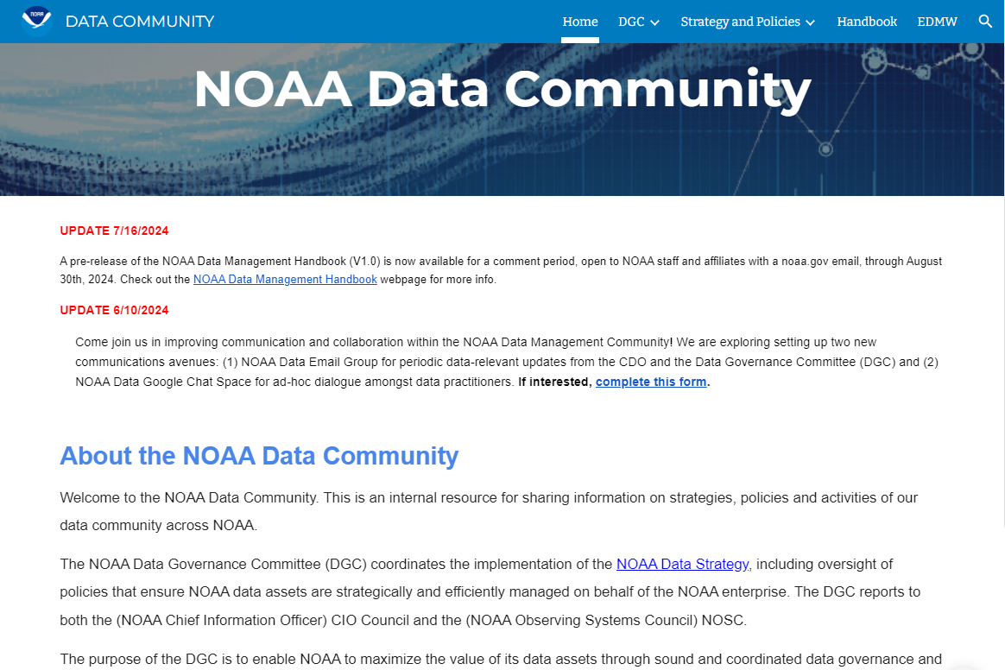
Join the NOAA Data Community
Come join your peers in the NOAA Data Community!
Take the first step by completing this form.
Then check out the many ways you can engage:
Data Community site: This is an internal resource for sharing information on strategies, policies and activities of our data community across NOAA.
Data Management Handbook: This site is your authoritative source for the current version as well as all updates, future versions (October 1st is the official release date!), and supporting documentation such as an FAQ and Toolkit.
DGC Monthly Meetings: Open to all - email noaadgc.execsec@noaagov to attend. Let us know if there’s a topic you’d like to hear, or if you’d like to present.
Eight active Working Groups / Task Teams: Reach out to your LO ACDO to learn more.
2025 Enterprise Data Management Workshop (EDMW): Coming soon! Meanwhile, check out prior EDMWs or share ideas with the EDMW Planning Team (edmw.planning.team@noaa.gov).
https://sites.google.com/noaa.gov/noaa-data/
* This is a NOAA-internal site.
** Questions/Feedback: noaadgc.execsec@noaa.gov

