Slide 1
FOIA and Google Meet Recordings
By Mark Graff, NOAA Bureau Chief Privacy Officer (BCPO), OCIO/CDO
May 8, 2024

Slide 2
Course Overview
This course will outline the FOIA implications of using Google Meet recording capabilities, and how those capabilities are complicated by required Privacy considerations.

Slide 3
Course Outline
Primary Considerations:
General Considerations
What is an Agency Record?
FOIA Considerations with Google Meet
Proactive Disclosures of Videos
Questions

Slide 4

General Considerations
All PII collections by an Executive Branch Agency have a baseline set of requirements, with several additional requirements for those which are collected within what is considered a System of Records. But those do not change the FOIA requirements for disclosure.

Slide 5
General Considerations
First, as noted by Robin, PII collections must be limited to only collections that are “relevant and necessary” to the performing NOAA’s mission.
This requirement is particularly difficult to satisfy merely for convenience, or in instances where the Meet recording has not previously been relevant and necessary to carry out a longstanding Meet.

Slide 6
General Considerations
Secondly—PII collections require notice and consent. Notice can be accomplished in one of two ways. Either through actual notice—in the form of an (e)(3) Statement (which we will discuss later), or through constructive notice, in the form of a System of Records Notice.

Slide 7
General Considerations
However, again, disclosures under (a)(3) of the FOIA are not prevented simply because notice and consent are absent, or because the records reflect PII being stored without an approved SORN. In this circumstance, FOIA can actually result in disclosing the very records that expose the agency to Privacy Act litigation.

Slide 8
General Considerations
Similar legal problems may arise if FOIA releases videos that reflect Hatch Act violations, or possibly give rise to Administrative Record challenges to agency decision-making.

Slide 9
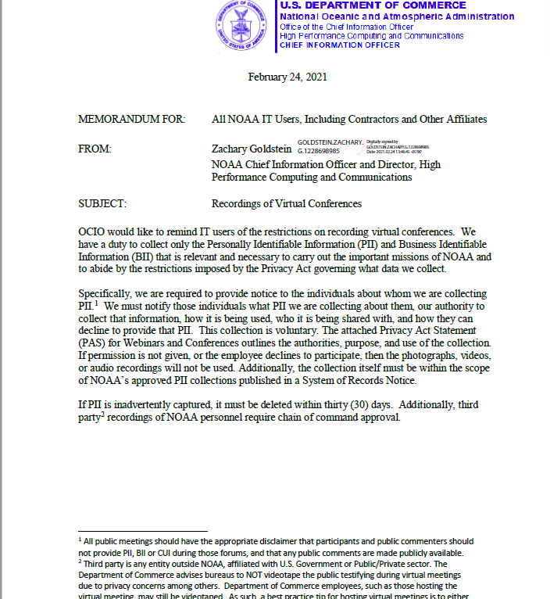
General Considerations
Zach Goldstein issued guidance on Feb. 24, 2021, regarding Virtual Conferences. The guidance is not specific to Google, and is applicable for any other recording medium as well.

Slide 10
General Considerations
Where CUI is not to be recorded with the application, that also means that virtually all videos will be released in their entirety if requested under the FOIA or Privacy Act Access. This requires some training for Line Office staff and leadership to understand the accessibility and need for self-awareness in creating videos, and to ensure that all statutory and regulatory requirements are met during recordings.
Notes:
Mention the need to avoid Hatch Act violations,

Slide 11

What is an Agency Record?
From a FOIA perspective, agencies are required to search for, and process, any “agency records” that are sought pursuant to the FOIA.
Notes:
5 USC 552(a)(3)(D)

Slide 12
What is an Agency Record?
“Agency Record” is a term of art that is not statutorily defined. Case law has defined that term in two major decisions:
Tax Analysts v. DOJ—The term “agency record” depends on “possession” and “control” of the record by the agency
Notes:
Department of Justice v. Tax Analysts, 109 S. Ct. 2841 (1989).

Slide 13
What is an Agency Record?
Burka v. HHS—The question of “control” (from Tax Analysts holding) depends on four factors:
1. The intent of the creator to relinquish control.
2. the ability of the agency to use/dispose of the record as it sees fit.
3. The reading/relying on the record by agency personnel.
4. The degree to which the document was integrated into agency record systems or files.

Slide 14
What is an Agency Record?
This creates an awkward middle space for some records—such as EM data or VMS data if it is stored outside of NOAA systems by a third party, and NOAA does not have direct access or records management control of the record, where the status of a record as an “agency record” may be debatable.

Slide 15
FOIA Considerations with Google Meet
In the context of Google Meet videoconferences, all recordings are automatically stored and populated into the Google Drive ecosystem. The NOAA0900 FISMA System accreditation boundary has an enclave within the Google ecosystem, and so the Google Meet recordings are created, stored, and controlled, entirely by NOAA within our NOAA0900 boundaries.

Slide 16
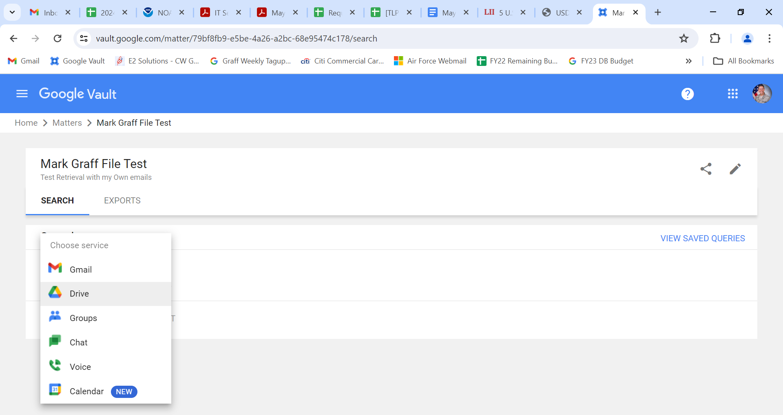
FOIA Considerations with Google Meet
As a result of this structure, when a FOIA request seeks Google Meet recordings—they are considered both agency records, and are retrievable by unique identifier in a SORN.

Slide 17
FOIA Considerations with Google Meet
This also means that, when the recording is transcribed, these recordings are not only “agency records” subject to the FOIA, but can be retrieved by any participant name, or by any words spoken by any participants.

Slide 18
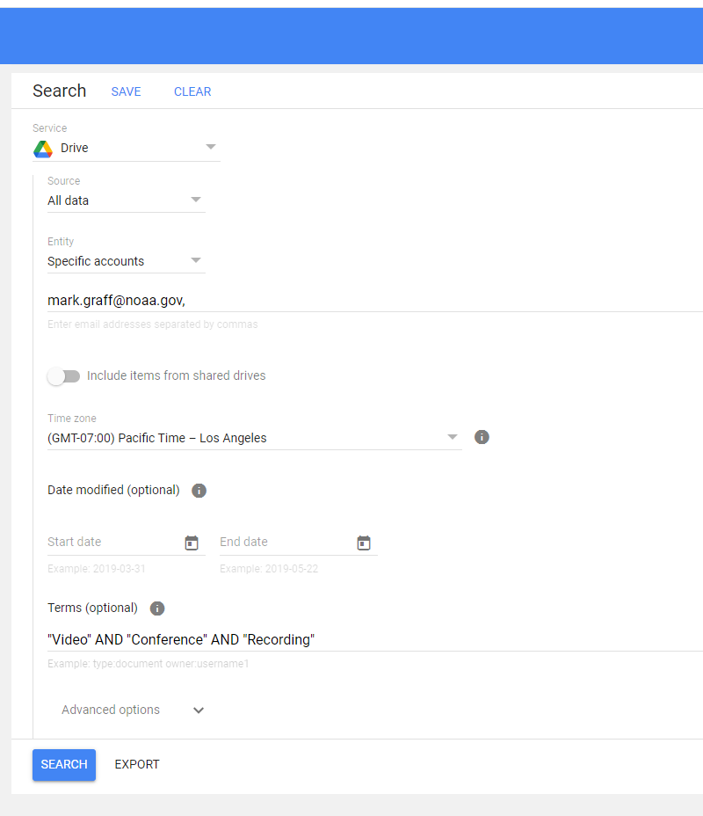
FOIA Considerations with Google Meet
This also means that, when the recording is transcribed, these recordings are not only “agency records” subject to the FOIA, but can be retrieved by any participant name, or by any words spoken by any participants.

Slide 19
FOIA Considerations with Google Meet
This also makes it necessary to ensure that all Privacy requirements are maintained, as a FOIA release of PII from an individual who did not consent to the scope of use and recording, or who is not covered appropriately by a SORN, could directly lead to Privacy Act litigation.

Slide 20
FOIA Considerations with Google Meet
Notably—Google Calendar does not currently have a direct extraction capability. As such, although Google Calendar is still subject to the FOIA, and is an agency record, it is not centrally searchable or retrievable. Similarly, employees still have the Privacy right to limit their Google Calendar, and can only be required to share their Calendar events with those who have authorization and need-to-know (usually their chain of command).

Slide 21

Proactive Disclosures of Videos
As the CIO Guidance on video recording indicates, Sensitive PII, and CUI are not to be recorded in Google Meet Recordings.

Slide 22
Proactive Disclosures of Videos
This also means—as mentioned earlier—that virtually all videos will be releasable if sought under a FOIA.
This also implies that, if the record is likely to be sought under the FOIA, it should be proactively disclosed under 5 USC 552(a)(2).

Slide 23
Proactive Disclosures of Videos
This also will decrease the resulting incoming requests, and lower the overall FOIA burden for an office needing to respond to FOIA requests. This also is an excellent resource library opportunity to compile training videos and tutorials for forward facing knowledge management.
Notes:
Reference the FOIA video training library.

Slide 24
Proactive Disclosures of Videos
In the event there is a video that for some reason requires redaction, there are only a handful of offices with the capability (NOS Comms/NOAA Video Studio, NOAA Office of Communications), although one solution is to utilize the FedRAMP’d version of Adobe Premier Pro, which is relatively inexpensive for a small handful of licenses and has video edit capability for the mp4 files generated by Google Meet recordings.

Slide 25
QUESTIONS?
QUESTIONS?

