Slide 1
Security Control Review and the Compliance Review Board
By Mark Graff, NOAA Bureau Chief Privacy Officer (BCPO), OCIO/CDO
April 25, 2023

Slide 2
Course Overview
This course will outline the PIA Security Control Concurrence, as well as the Compliance Review Board process.

Slide 3
Course Outline
Primary Privacy Considerations:
DOC Review of PIAs
Security Control Review NOAA CIO
The CRB Process
Common Concerns
Questions

Slide 4
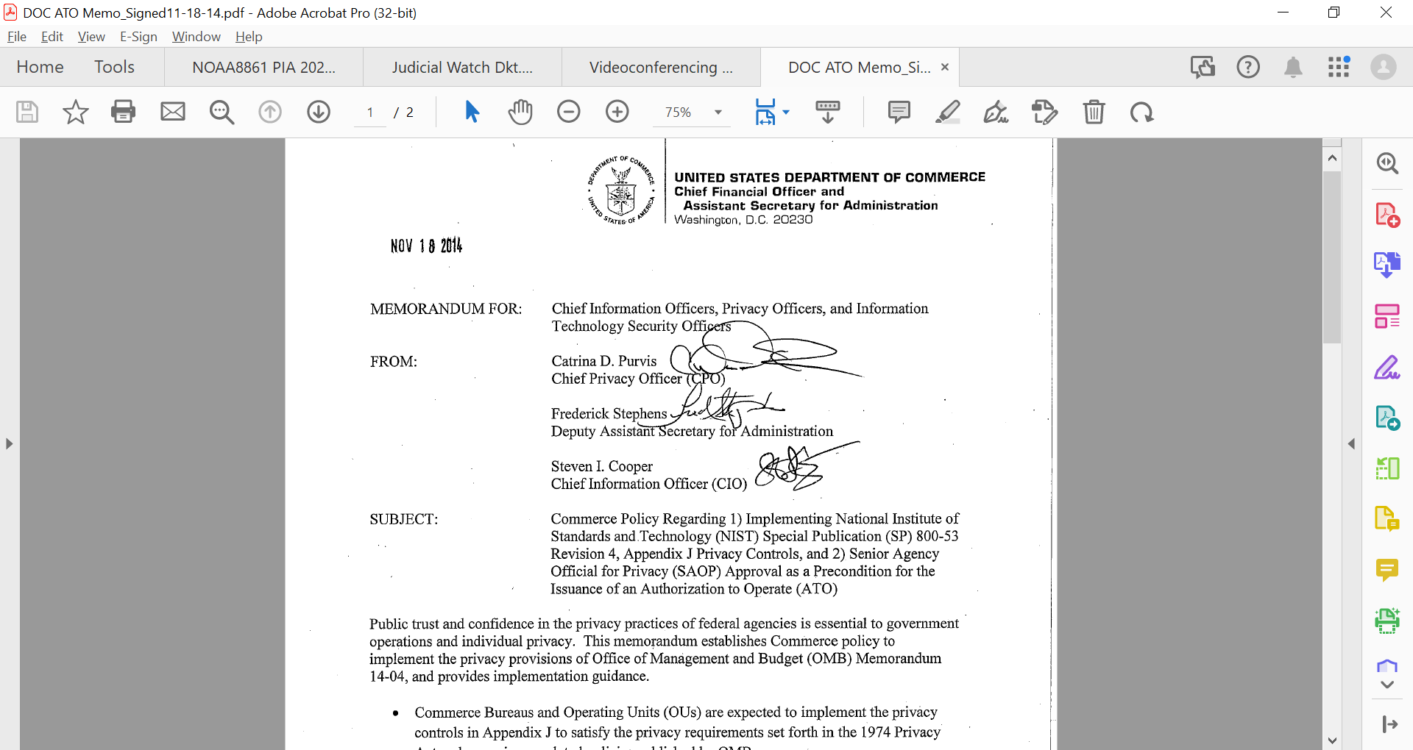
DOC Review of PIAs
Since 2014, DOC has required the completion of a PIA as a pre-requisite to the issuance of an ATO. Authority for the approval of a PIA rests with the Senior Agency Official for Privacy (SAOP).

Slide 5

DOC Review of PIAs
That authority has been delegated to the Bureau Chief Privacy Officer (BCPO) for PIAs for systems that are a NIST 800-122 Low Confidentiality Impact Level.

Slide 6
DOC Review of PIAs
Similarly, BCPOs are allowed to submit for re-certification those PIAs that have undergone no changes that impact Privacy during the last year.
This re-certification is only available for three years. At that point, another CRB will be necessary, even if there have been no changes that impact Privacy.

Slide 7
Security Control Review NOAA CIO
Historically, CIO sent a representative to participate in the Compliance Review Board (CRB). However, they have since delegated that authority to the Bureau CIO. As a result, prior to submission to the Department, NOAA seeks concurrence from the NOAA CIO on the Security Control Posture as it relates to the protection of PII for the FISMA System.

Slide 8

Security Control Review NOAA CIO
This consists of submitting the PTA, PIA, Control Assessment Worksheet, and a listing of any open POA&Ms to Zach Goldstein, as well as Bill Rogers.

Slide 9
Security Control Review NOAA CIO
The summary of the system includes an overview of:
Open POA&Ms, their impact to Privacy, and whether or not they have reasonable completion times.
Whether the PIA is a re-certification or will require a CRB.
Identification of any residual risk.
Any request for an assumption of risk.

Slide 10
The CRB Process
Following the submission of the Security Control Concurrence review, and submission of the PIA review package to the Department, DOC/OPOG will schedule the CRB, with the SAOP, Deputy Director for Privacy Compliance, the ITSO, ISSO, BCPO, and NOAA’s Privacy Act Officer, participating.

Slide 11
The CRB Process
The review will cover four main areas:
System overview, touching on PII collected, the use, purpose, and necessity of the collection, as well as a review of who has access, and their authorization/need to know the data.
Privacy Act Compliance—including SORN coverage as well as Notice and Consent.
Security Control review—determining whether or not all controls applicable to the system are implemented.
A review of the SORNs and any impact to Privacy.

Slide 12
Common Concerns
Many of the same issues seem to crop up during the CRB Process. In order to try to get in front of these, the following issues should be addressed before submitting the final PIA documentation for review and approval:
Ensure that the NIST 800-122 Confidentiality Level is the same or less than the FIPS category. If it is higher, then there will need to be Privacy Overlays implemented to provide additional protection for PII.
Ensure that in all instances where possible, those asked to provide PII to the Bureau have been provided notice and the opportunity to consent, usually in the form of an (e)(3) statement.

Slide 13
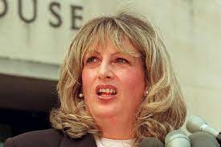
Common Concerns
3. Ensure that all websites that collect PII have a Privacy Act Statement, and that a link to the Privacy Policy is available on forward-facing websites.
4. Do not share PII outside of the scope of those with authorization and need-to-know, or those that are covered by Routine Uses in the SORN, even to other Federal Employees.

Slide 14
Common Concerns
5. Ensure that if there are any controls that apply to the FISMA System, they are either implemented or have comments explaining the deficiency, with a POA&M in place to remedy the deficiency.
6. Review the PII collections and determine if there is sufficient SORN coverage for the nature of collections and purposes for which the PII is being used. This includes confirming that the collections and uses of the PII are accurate.

Slide 15
QUESTIONS?
QUESTIONS?

