Slide 1
Privacy Act Statements
By Mark Graff, NOAA Bureau Chief Privacy Officer (BCPO), OCIO/CDO
April 25, 2023

Slide 2
Course Overview
This course will outline the necessity and elements of an (e)(3) Statement, also known as a Privacy Act Statement.

Slide 3
Course Outline
Primary Privacy Considerations:
Statutory Requirements
Elements and Purpose
Collections not Requiring a PAS
Common Concerns
Questions

Slide 4
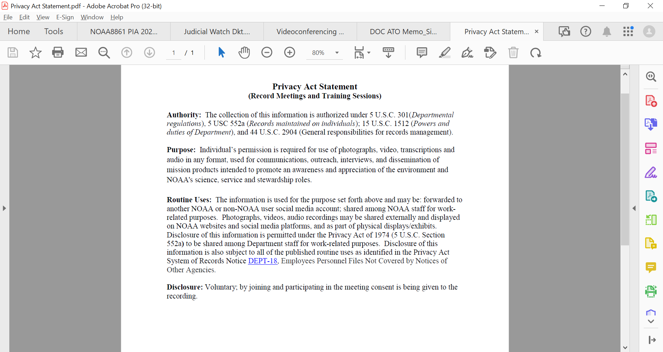
Statutory Requirements
The Privacy Act Statement is the required notice outlined in 5 USC 552a(e)(3). It outlines the method for actual notice when requesting PII from individuals that will be stored within a System of Records.

Slide 5
Statutory Requirements
The notice must include the following four provisions:
The authority behind the request for PII.
The purpose for which the PII is intended to be used.
The routine uses the information will be used for.
Whether the information solicited is voluntary or mandatory and what the results would be for refusing to provide the PII.

Slide 6
Elements and Purpose
The first element—outlining the authorities—needs to identify the underlying Statute, EO, or Presidential directive behind the collection. Most agencies will also normally list the SORNs in this portion that apply to the collection.
The second element—the purpose—must inform the individual of how it will be used.
Notes:
It is noteworthy that the purpose must be disclosed, although the outcome does not. For example--Cardamone v. Cohen, No. 3:97CV540H, slip op. at 4-5 (W.D. Ky. Sept. 30, 1999), individual was notified the information would be used in the investigation. The investigation resulted in termination. Not the same as a Miranda Warning—general use of the information is sufficient. But cross reference Cooper v. FAA.

Slide 7
Elements and Purpose
The third element—routine uses—should directly correlate to the SORNs that are listed in the first element. Each of the SORNs listed will have a number of routine uses within the publication, and no routine uses should be listed that cannot be found in those SORNs.
The fourth element, is to allow the individual to make what OMB Guidelines referenced as informed consent on whether or not to provide their PII.
Notes:
As to routine uses—Courts have also chastised agencies who collect PII from third parties without providing notice of how the PII will be used. See Usher v. Sec’y of HHS, 721 F.2d 854, 856 (1st Cir. 1983) (costs awarded to plaintiff due to agency “intransigence” in refusing to provide information specified in subsection (e)(3) to third party). It is worth noting, this is particularly a concern if the collection could be collected directly from the individual about whom it concerns in light of the (e)(2) requirement that the PII be collected directly from the individual about whom it pertains.
OMB 1975 Guidelines..

Slide 8

Collections that Don’t Require a PAS
There are some collections that fall outside of the scope of the notice requirements.
Notably—if the PII will not be stored within a System of Records, no PAS is required.
Notes:
For example—email, in and of itself, does not require a PAS only because it seeks PII, as the email system has been determined by DOC/GC to not constitute a System of Records.

Slide 9

Collections that Don’t Require a PAS
Similarly--(e)(3)(D) does not require an agency to provide notice of the specific criminal penalty that may be imposed for failure to provide information.
Notes:
See, e.g., United States v. Bishop, 946 F.2d 896, at *4 (6th Cir. Oct. 23, 1991).

Slide 10
Common Concerns
Agencies cannot list a collection as voluntary, but then make the collection mandatory as a condition of employment without including it in the PAS.
Notes:
Reference meet recordings.
“clearly did not follow the Act’s requirements because the [form] did not indicate whether filling out the form was voluntary or mandatory or, alternatively, because [plaintiff’s] supervisors ordered him to fill out the form even though filling it out was voluntary.” Sweeney v. Chertoff, 178 F. App’x 354, 357 (5th Cir. 2006).

Slide 11

Common Concerns
Failure to give proper notice at the time of the collection precludes the agency from later relying on routine uses. Similarly, it prevents the agency from being able to share the PII with other agencies.
Notes:
In Covert v. Harrington, a divided panel of the Court of Appeals for the Ninth Circuit held that an agency component’s failure to provide actual notice of a routine use under subsection (e)(3)(C), at the time at which information was submitted, precluded a separate component of the agency, the Inspector General, from later invoking that routine use as a basis for disclosing such information. 876 F.2d 751, 755-56 (9th Cir. 1989). Info in their personnel security files referred to OIG, and then to DOJ for prosecution.

Slide 12
Common Concerns
Often the (e)(3) requirement is related to the (e)(2) requirement of being reasonably practicable to collect the PII directly from the individual—and thus provide the individual PAS. PII collected as part of the investigation often cannot be collected directly from the individual, and as such, also will not have an accompanying PAS.
Notes:
Hubbard v. EPA, 809 F.2d 1, 6 n.8 (D.C. Cir. 1986) (defendant was not forbidden from using relevant information from third parties in hiring decision and made “practicable” effort to collect information from plaintiff when asked whether plaintiff knew source of leaks in previous investigation plaintiff had worked on).

Slide 13
QUESTIONS?
QUESTIONS?

