Slide 1
Controls and Data Security
Justin May
OCIO | CSD
27 Apr 23
CUI//ISVI//FEDCON

Slide 2
OUTLINE
PURPOSE
IA-2
IA-8
SC-8
SC-28
QUESTIONS
Addendum*
CUI//ISVI//FEDCON

Slide 3
PURPOSE
Describe and discuss required security controls as mandated through EO14028 and impact data at rest, data in transit, and authentication.
CUI//ISVI//FEDCON
Notes:
Executive Order on Improving the Nation’s Cybersecurity
https://www.whitehouse.gov/briefing-room/presidential-actions/2021/05/12/executive-order-on-improving-the-nations-cybersecurity/
“The United States faces persistent and increasingly sophisticated malicious cyber campaigns that threaten the public sector, the private sector, and ultimately the American people’s security and privacy. The Federal Government must improve its efforts to identify, deter, protect against, detect, and respond to these actions and actors. The Federal Government must also carefully examine what occurred during any major cyber incident and apply lessons learned. But cybersecurity requires more than government action. Protecting our Nation from malicious cyber actors requires the Federal Government to partner with the private sector. The private sector must adapt to the continuously changing threat environment, ensure its products are built and operate securely, and partner with the Federal Government to foster a more secure cyberspace.”

Slide 4
Identification and Authentication (Organizational Users) {IA-2}
Uniquely identify and authenticate organizational users and associate that unique identification with processes acting on behalf of those users.
  Organizations can satisfy the identification and authentication requirements by complying with the requirements in HSPD 12. Organizational users include employees or individuals who organizations consider to have an equivalent status to employees (e.g., contractors and guest researchers).
CUI//ISVI//FEDCON
Notes:
Applicable to FIPS199-Low/Moderate/High Impact
Unique identification and authentication of users applies to all accesses other than those that are explicitly identified in AC-14 and that occur through the authorized use of group authenticators without individual authentication.
Recent Data Call:
Authentication Method for Enterprise Identities
If contractor operated system, does the contract require MFA credentialing for Enterprise Identities?
Estimate Completion Date for implementing MFA for Enterprise Identities (IA-02)
Delay reason for not implementing MFA for Enterprise Identities
If system cannot implement MFA provide the rationale for why it cannot be implemented
Describe compensating security controls in place, if MFA cannot be implemented
Enter date of last independent assessment OR OIG/GAO Audit of the compensating controls
AC-14: Permitted Actions Without Identification or Authentication
“Information system security plans must document and provide supporting rationale for user actions not requiring identification or authentication. Any variance must be approved by the Authorizing Officials and must be documented as an approved risk acceptance."

Slide 5
Identification and Authentication (Non-Organizational Users) {IA-8}
Uniquely identify and authenticate non-organizational users or processes acting on behalf of non-organizational users.
  Non-organizational users include system users other than organizational users explicitly covered by IA-2. Non-organizational users are uniquely identified and authenticated for accesses other than those explicitly identified and documented in AC-14.
CUI//ISVI//FEDCON
Notes:
Applicable to FIPS199-Low/Moderate/High Impact
Recent Data Call:
Authentication Method for Public Identities
Estimate Completion Date for implementing MFA for Public Identities (IA-08)
Delay reason for not implementing MFA for Enterprise Public Identities
If system cannot implement MFA provide the rationale for why it cannot be implemented
Describe compensating security controls in place, if MFA cannot be implemented
Enter date of last independent assessment OR OIG/GAO Audit of the compensating controls

Slide 6
Transmission Confidentiality and Integrity {SC-8}
Protect the confidentiality and/or integrity of transmitted information.
  Protecting the confidentiality and integrity of transmitted information applies to internal and external networks as well as any system components that can transmit information, including servers, notebook computers, desktop computers, mobile devices, printers, copiers, scanners, facsimile machines, and radios.
  DOC/NOAA: confidentiality and integrity.
CUI//ISVI//FEDCON
Notes:
Applicable to FIPS199-Moderate/High Impact
Recent Data Call:
Data in Transit (DIT) is Encrypted (Y/N)
Estimate completion date (MM/DD/YYYY) for implementing DIT (SC-08)
Reasons for delay in meeting DIT (SC-08)
If system cannot implement DIT and/or DAR provide the rationale for why it cannot be implemented

Slide 7
Protection of Information at Rest {SC-28}
Protect the confidentiality and/or integrity of the information at rest.
  Information at rest refers to the state of information when it is not in process or in transit and is located on system components.
  DOC/NOAA: At minimum, sensitive PII and sensitive BII, FIPS 199 moderate-impact and high-impact information.
    Can be done at the application level
CUI//ISVI//FEDCON
Notes:
Applicable to FIPS199-Moderate/High Impact
…..Such components include internal or external hard disk drives, storage area network devices, or databases. However, the focus of protecting information at rest is not on the type of storage device or frequency of access but rather on the state of the information. Information at rest addresses the confidentiality and integrity of information and covers user information and system information.
Recent Data Call:
Sensitive Data at Rest (DAR) is Encrypted (Y/N/N/A - Low system)
Estimate completion date (MM/DD/YYYY) for implementing DAR (SC-28)
Reasons for delay in meeting DAR (SC-28)
If system cannot implement DIT and/or DAR provide the rationale for why it cannot be implemented
ITSM for SC-28:
Information system owners must encrypt sensitive PII and sensitive BII FIPS 199 moderate-
impact and high-impact information at rest and in transit, unless encrypting such information is technically infeasible or would demonstrably affect the ability of agencies to carry out their respective missions, functions, or operations; and the risk of not encrypting is accepted by the
authorizing official and approved by the agency CIO, in consultation with the SAOP, as appropriate.

Slide 8
QUESTIONS
If you think of a question after this briefing is over, please reach out to us at noaa.rmc@noaa.gov
THANK YOU
CUI//ISVI//FEDCON
Notes:
Note for Mark: Risk Assessment Tools: https://www.nist.gov/itl/applied-cybersecurity/privacy-engineering/collaboration-space/focus-areas/risk-assessment/tools

Slide 9
Addendum
Use only approved Government Furnished Equipment (GFE) to conduct government business.
Protect sensitive information and data that resides on mobile Government Furnished Equipment and/or approved portable storage devices (USB drives, CD-ROMs, etc.) that are under the users control.
SysAdmins: Know the sensitivity of the data they handle and take appropriate measures to protect it.
https://sites.google.com/noaa.gov/noaa-csd-rmf/policies/itsm-itsbp
Notes:
Kiteworks - should be used for communicating sensitive information outside of NOAA. outside includes outside of the NOAA domain.

Slide 10
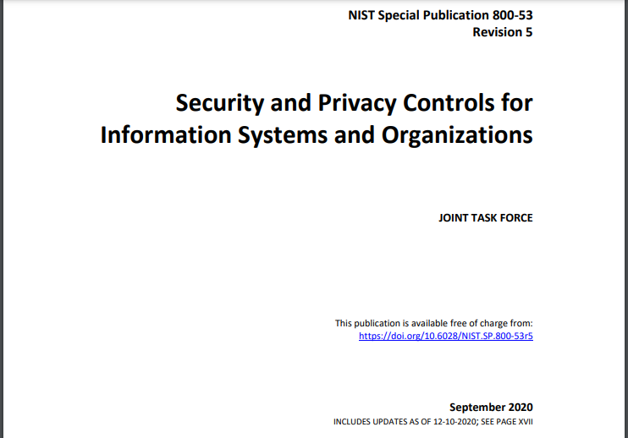
Backup Slides

Slide 11
NIST SP 800-53 Rev 5 ExSum
Revision 5 of this foundational NIST publication represents a multi-year effort to develop the next generation of security and privacy controls that will be needed to accomplish the above
objectives. It includes changes to make the controls more usable by diverse consumer groups (e.g., enterprises conducting mission and business functions; engineering organizations developing information systems, IoT devices, and systems-of-systems; and industry partners building system components, products, and services).

Slide 12
NIST SP 800-53 Rev 5 ExSum
The most significant changes to this publication include:
• Making the controls more outcome-based by removing the entity responsible for satisfying the control (i.e., information system, organization) from the control statement;
• Integrating information security and privacy controls into a seamless, consolidated control catalog for information systems and organizations;
• Establishing a new supply chain risk management control family;
• Clarifying the relationship between requirements and controls and the relationship between security and privacy controls; and

Slide 13
NIST SP 800-53 Rev 5 ExSum
• Separating control selection processes from the controls, thereby allowing the controls to be used by different communities of interest, including systems engineers, security architects, software developers, enterprise architects, systems security and privacy engineers, and
mission or business owners;
• Removing control baselines and tailoring guidance from the publication and transferring the content to NIST SP 800-53B, Control Baselines for Information Systems and Organizations;
• Incorporating new, state-of-the-practice controls (e.g., controls to support cyber resiliency, support secure systems design, and strengthen security and privacy governance and accountability) based on the latest threat intelligence and cyber-attack data.

