Slide 1
Google Meet Recording
By Mark Graff, NOAA Bureau Chief Privacy Officer (BCPO), OCIO/CDO
April 25, 2023

Slide 2
Course Overview
This course will outline the Privacy requirements and process to schedule and record conferencing using Google Meet.

Slide 3
Course Outline
Primary Privacy Considerations:
General Privacy Restrictions
Guidance from NOAA CIO
Special Considerations with Google Meet
Privacy Act Statement
Questions

Slide 4
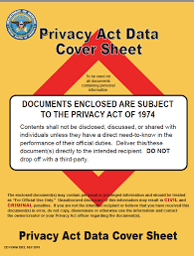
General Privacy Considerations
All PII collections by an Executive Branch Agency have a baseline set of requirements, with several additional requirements for those which are collected within what is considered a System of Records.

Slide 5
General Privacy Considerations
First, PII collections must be limited to only collections that are “relevant and necessary” to the performing NOAA’s mission.
This requirement is particularly difficult to satisfy merely for convenience, or in instances where the Meet recording has not previously been relevant and necessary to carry out a longstanding Meet.

Slide 6
General Privacy Considerations
Secondly—PII collections require notice and consent. Notice can be accomplished in one of two ways. Either through actual notice—in the form of an (e)(3) Statement (which we will discuss later), or through constructive notice, in the form of a System of Records Notice.

Slide 7
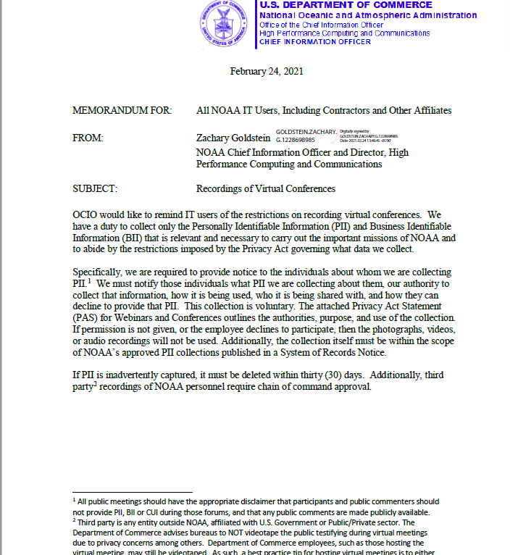
Guidance from NOAA CIO
Zach Goldstein issued guidance on Feb. 24, 2021, regarding Virtual Conferences. The guidance is not specific to Google, and is applicable for any other recording medium as well.

Slide 8
Guidance from NOAA CIO
Significant provisions of the guidance include:
Notice must be provided to all parties through Privacy Act Statements.
All collections are voluntary. There are no mandatory Google Meet recordings.
Best practice is to record in Spotlight mode, or method to avoid collecting facial images when possible.
No third party collections without SORN coverage.

Slide 9
Special Considerations with Google
Google does not restrict recording capability to only those with the permissions on their account. Rather, any participant to a meeting can start a recording, causing a collection to be incorporated into the NOAA0900 boundary. This creates a significant Privacy Act liability, and requires strict control of the training and creation of recordable Meet events.

Slide 10

Special Considerations with Google
Google also associates the recording with the event, rather than the participants. This also allows for singular recording sessions to be re-named and re-scheduled.

Slide 11
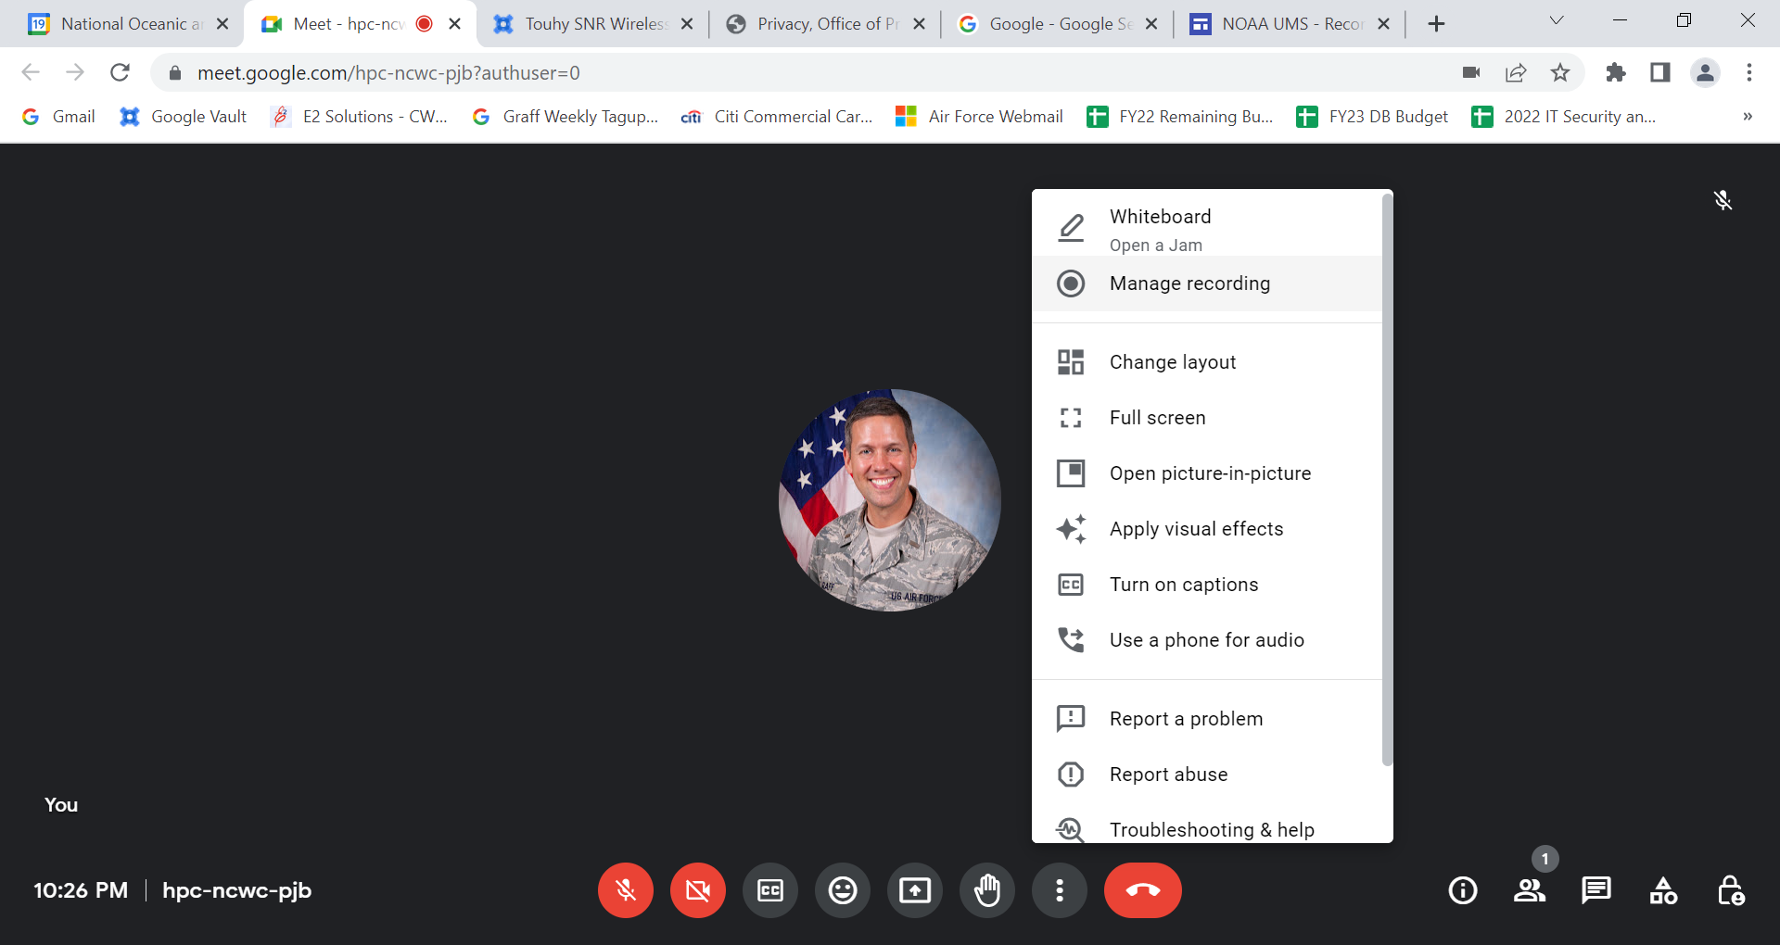
Special Considerations with Google
As such, a single recording session, with editing rights transferred to someone trained in appropriate Privacy Act restrictions, can be re-scheduled, re-named, and utilized indefinitely, for multiple recording sessions.

Slide 12
Special Considerations with Google
As a solution, NOAA Privacy has centralized Privacy training for those who need to conduct Google Meet recordings. This includes a recorded overview of the general Privacy considerations and directions on how to record, and a standardized Privacy Act Statement to accompany the recording for all participants.
As such, users can reach out to NOAA.Privacy@noaa.gov and request a recording session be created, and we will direct them to the training and create the recording session for them.

Slide 13

Privacy Act Statement
As noted before—all recordings require Notice and Consent. When conducting a recording, all participants need to receive a Privacy Act Statement (PAS), which we will provide with all recording sessions. Although a PAS does not need to be signed, it must be provided to all individuals whose PII will be collected prior to recording. The PAS can also be tailored to your specific collection, if needed.

Slide 14
Privacy Act Statement
You will note that—because no third party PII can be collected without consent—no background individuals can be recorded, and doing so would automatically constitute a Privacy Act Violation. For that reason, individuals should turn off their cameras when possible during recording sessions, and should not record in a location where a recording could capture a bystander.

Slide 15
Privacy Act Statement
The Privacy Act Statement outlines four important provisions—
Authority
Purpose
Routine Uses/Sharing
Voluntary vs. Mandatory Collection

Slide 16
QUESTIONS?
QUESTIONS?

