Slide 1
FOIAXpress Transition Alaska Roundtable
Prepared by Mark H. Graff
NOAA FOIA Officer/Bureau Chief Privacy Officer
OCIO/CDO
mark.graff@noaa.gov; (301)-628-5658

Slide 2
Agenda
Current Status
Request Tracking
UAT Testing
FOIAXpress Overview
Questions
2
Notes:
1.

Slide 3


Current Status
FOIAOnline went dark as of March 31, 2023, and the new FOIAXpress system was not scheduled to go live until April 21. This means that no legacy cases that were in the system are accessible and all new requests have had to be received offline for later ingest into FOIAXpress.
3
Notes:
1.

Slide 4

Current Status
As a result, unless request files were already maintained offline, that means we cannot yet access the underlying FOIA submissions, fee waiver requests, records, and all other artifacts associated with the request are unavailable, making processing the request much more difficult.
4
Notes:
1.

Slide 5
Current Status
Closures have had to be done offline, by email, along with records disclosures that are either done through email—or if too large or containing PII disclosures (to 1st person requesters or responding to consultations)—through Kiteworks folder sharing.
5
Notes:
1.

Slide 6
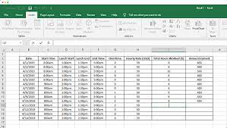
Request Tracking
Because FOIAOnline went offline prior to FOIAXpress going live, that necessitated creating an ad hoc request tracking method, and separate FOIA repository.
6
Notes:
1.

Slide 7
Request Tracking
The interim request tracking method was suggested by NOAA, and then adopted throughout the Department as the approach for tracking cases, managing records and communications, and maintaining all required DOJ reportable metrics.
7
Notes:
1.

Slide 8
Request Tracking
The interim tracking consists of a live collaborative spreadsheet, tracking each of the reportable case status metrics for each request. These fields will then be used to (1) update actions taken on existing cases once the old status is migrated into FOIAXpress and (2) input new cases for tracking and case assignment once FOIAXpress goes live.
8
Notes:
1.

Slide 9
UAT Testing
NOAA was invited to test the new system, exploring each of the new features and finding areas of failure. NOAA refused to sign off on acceptance at this time until several critical failures were addressed—notably the inability to transmit correspondence or records directly through the new system, and inaccessibility of the new systems’ forward facing portal (PAL).
9
Notes:
1.

Slide 10
UAT Testing
The testing did show several improvements in the new system over FOIAOnline, including greatly improved reporting capabilities, a better case visibility, native redaction ability, and native records deduplication.
Below is a walkthrough of the general functionality of FOIAXpress, which likely will come online in phases—currently planning for general accessibility and processing first (hopefully now or in the next few days), followed by full data migration (by May 1), followed by PAL accessibility.
10
Notes:
1.

Slide 11
Opening Dashboard
After Logging on, FOIAXpress has a slightly different feel, in part due to an immediate “Dashboard” display, which has a metric and graph-based summary of assigned cases.
11

Slide 12
Opening Dashboard
This is a big improvement over FOIAOnline, which required extractions and manual compilation of Bureau and Office-level metrics.
12
Notes:
1. The Navigation Bar along the top takes you to different parts of the application.
2. Clicking your User Name opens options to set preferences and view your user profile.
3. Clicking the Help button allows you to open manuals, version information, helpdesk information, and any relevant links your FX admin has configured.
4. The Refresh icon retrieves the most recent data within your FX application.
5. The Search field allows you to search FX quickly and easily from any page.
6. The links in My Work Summary provide easy access to all of your work items.
7. The links in Messages provide easy access to items in your FX Inbox.
8. The links in Group Queue Assignments provide a view of group queue assignments.
9. Clicking on the different Graphs takes you to that subset of requests.

Slide 13
Request Creation
Request input is relatively similar to FOIAOnline, with a convenient saved requester field that allows for repeat requesters to be pre-populated at intake.
13

Slide 14
Request Creation
Most requester fields are the same as from FOIAOnline, and the requester screen is actually quite similar in feeling. “PAL” requester essentially distinguishes those with accounts
to receive records
directly from the
forward facing
FOIAXpress
portal.
14
Notes:
Enter in the requester’s information to find an existing requester.
Search existing requester’s to see if this requester already has a profile.
Select the requester from existing requester’s to pre-populate their info. Otherwise, select “create requester” if it is a new requester.

Slide 15
Request Creation
However, with those small distinctions, the input fields and requester fields are very recognizable from FOIAOnline.
15
Notes:
This is to create a requester if it is the requester’s first time.

Slide 16
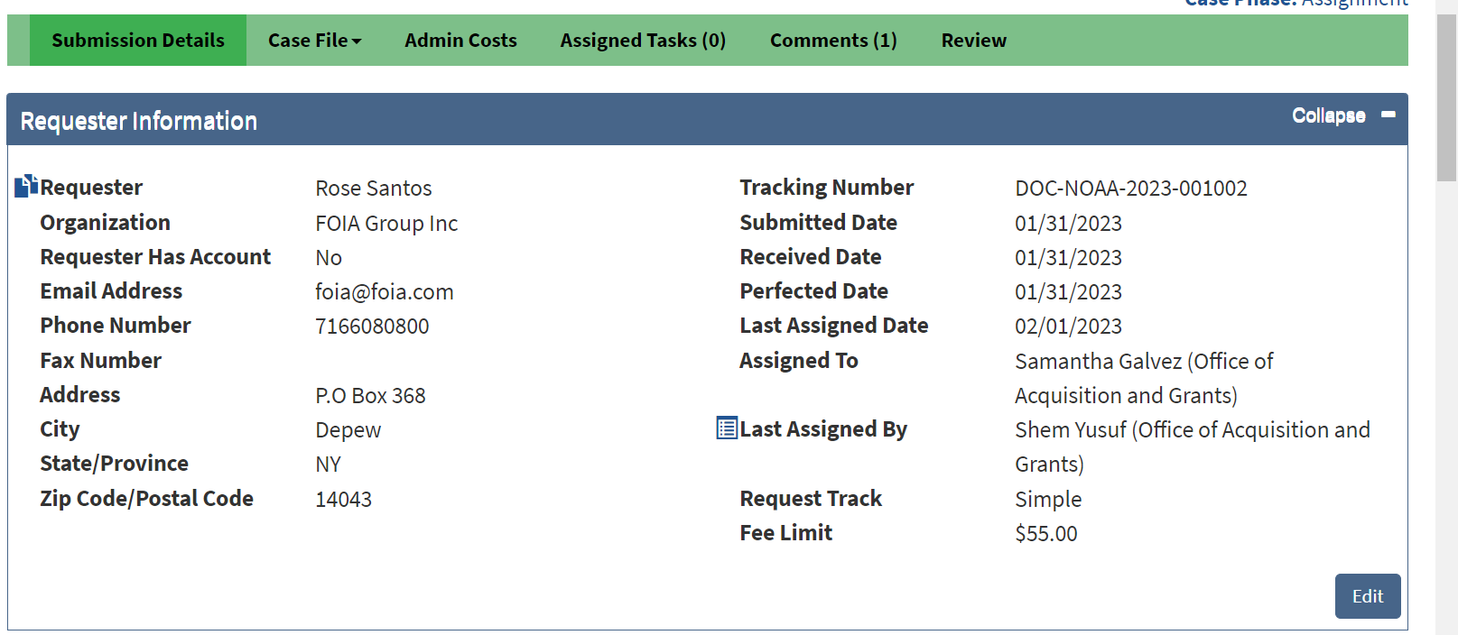
Request Creation
FOIAOnline has a similar Requester Information page with case lookup that is nearly identical, and should look very familiar.
16

Slide 17
Navigation at Request Screen
FOIAXpress has some slightly different navigation fields that are somewhat more straightforward than FOIAOnline.
17
Notes:
1. Breadcrumb Navigation: This shows you exactly where you are in the application and allows you to retrace your steps without using your browser’s back button.
2. Request Number: Once you save a request, FX assigns it a unique number in the system. There are also icons for quick access to the Request Details Report and the Correspondence Log for this request.
3. Processing Days: Time left to process the request (minus weekends and holidays). This is based on the Target Date in the Request Details.
4. Status: Indicates what stage the request is currently in.
5. Next: This button moves you the next expected action in the workflow based on the request status. This is helpful when learning FX, as it guides you through the process flow.
6. Request Menu: A list of all available actions and utilities within the application. Not all these options are required; they depend on your workflow.

Slide 18
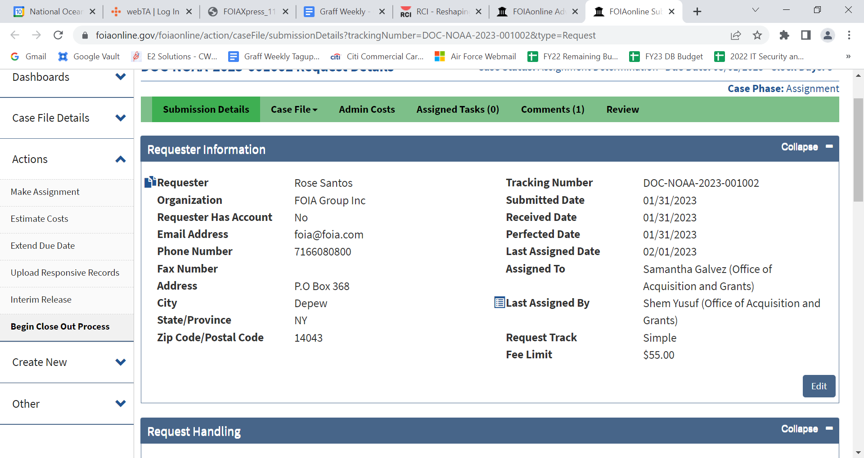
Navigation at Request Screen
The left column in the Request Menu is similar to FOIAOnline. Here they are side-by-side for Comparison.
18
Notes:
A. Request Information: View and edit details about the request.
B. Assign Users: Assign this request to a specific user or group.
C. Correspondence: Send and receive communication regarding the request.
D. Request for Documents: Send a request for additional documentation to another group or organization.
E. Electronic Document Review: Load large volumes of data, such as emails, for searching and indexing.
F. Add/Search/View Documents: Perform reviews and redactions on single files or groups of files.
G. Fees/Billing: Create invoices and receive payments.
H. Final Actions: Create and accept final disposition on the request.
I. Deliver Documents: Process the final deliverable for the requester.
J. Stop the Clock: Pause the timer that calculates the date the request is due.
K. Notes: Additional details on the request.
L. Messages To/From Requester: View correspondence sent/received via the portal
M. Task Reminders: Set and distribute reminders for tasks due on the request.
N. Extensions: Add processing time to the request, if needed.
O. Transfer Request: Move the request to another Action Office in your organization.
P. Appeals: Create and manage appeals related to the request.
Q. Response Package Approval: Review and approve the package to be sent to the requester.
R. Logs/Reports: View additional log and reporting info for this request.
S. More Actions: Additional miscellaneous actions you can take on the request.

Slide 19
Sending/Receiving Correspondence
Creating correspondence is a bit easier in FOIAXpress, as it is designed to integrate with a native email platform, has read/delivery receipts, and can send attachments and pre-configured templates, with future send dates.
19
Notes:
1. The Correspondence screen has three tabs. The screen changes based on the selected tab:
a. Send Correspondence: Send outgoing communication.
b. Receive Correspondence: Upload received communications.
c. Correspondence Log: View a list of all outgoing and incoming messages related to this request. This option also includes a link to download all correspondence for the request. You can access this log from any page in the folder using the button beside the request number.
2. Under Add From, you can add attachments to your messages. Options include adding from Letter Templates, a local Scanner, your local Disk, the Correspondence Log, etc.
3. The Dispatch Mode determines how the message is sent out from FX, while Delivery Mode determines which format is used to deliver the message to your recipient.
4. Email Options allows you to configure your email message content, recipients, and sender details.

Slide 20
Sending/Receiving Correspondence
Receiving Correspondence acts like “Other Correspondence” in FOIAOnline, allowing for upload of incoming messages and files, into the correspondence log.
20
Notes:
Ribbon to determine “Send” “Receive” or “Correspondence Log”
Template Selection and referencing how the correspondence was received. This is much more beneficial for creating a Motion for Summary Judgment in tracking the back and forth between the agency and the requester, showing date, and nature of correspondence (e.g., snail mail, email, etc.).
Drag and Drop of files from correspondence.
CORRESPONDENCE LOG:
(1) Correspondence Log listing all messages sent and received. The details are provided in the various columns on this page, including the (2) Status of the messages (whether it was Sent or Received). In addition, there are several (3) Actions to take on log items, including (A) Downloading all correspondence in the log, viewing (B) Details, (C) Redacting correspondence and more. Notice the date and time organization of the correspondence log, which makes tracking infinitely easier than in FOIAOnline. We requested this feature for years in FOIAOnline, and are excited it will automatically be included in FOIAXpress.

Slide 21
Request for Documents
Tasking for a search is referred to as a “Request for Documents” in FOIAXpress. It is issued to Staff and Line Offices and has a bit more capability than current taskings, including sending reminders, and relaying accompanying messages.
21
Notes:
1. New: Create a new RFD. This doesn’t require making a selection from the RFD list.
2. Take Action: Perform an action on the selected RFD. This generally involves changing the status to reflect a change that has taken place, and it is recorded in the Status column.
3. View: Open a screen featuring the details about the request.
4. Delete: Delete an RFD.
5. Messages: View Messages associated with this RFD (a count of messages is included here)
6. Send Email/Reminder: Send a message or reminder email to the assignee.
7. Send Reminder by Print: Print a reminder to hard copy for distribution or record keeping.
8. Action(s) Log: View a history of actions taken on this request, including relevant details on who did what.

Slide 22
Request for Documents
A new request for documents has a different feel than FOIAOnline, but generally the same information in the tasking.
22
Notes:
Request for Documents mode: Select how the request is sent. By default, Send via Email/Save is selected. If your FX instance has Collaboration enabled, there is also the option to select Send via Collaboration. If selecting Send via Collaboration, only fields (2) and (3) are available
2. Request for Documents Information: This is where you include the details of the request, such as who it’s being sent to and why, for reference within FX. You must also select a Request Date and Due Date. When setting the Due Date, it is a best practice to use the Add Reminder checkbox to set reminders for the request.
3. Send To: Program Offices: Select a Program Office where you’d like to assign the request. You need to have program offices added to your FX environment if you’d like to assign requests this way. You can also send the request to another program office manually, see #4 below.
4. Dispatch Mode: Determine how to send the request. FX allows you to send via email through the application, but you can also print or save the request as well.
5. Send to: Other Email Recipients: This field allows you to select a recipient at another program office by entering the address manually or by selecting from the Global Address List.

Slide 23
Request for Documents
Step Two allows for attachments (the request, consultation cover letter, etc.) and other email options. It really functions the same as the send correspondence interface in FOIAOnline.
23
Notes:
1. Add From: Add an attachment to the RFD using the available attachment methods.
2. Email Options: Configure your outgoing message (this field may change depending on your selections in Step 1, but you should expect to configure the actual content of your message at this step.)

Slide 24
Fulfilling the Request for Documents
For a Staff or Line Office to fulfill the tasking, they mark the status, date complete, and add the attachments (if any).
24
Notes:
1. Status: Update the Status of the RFD. This could be something like Denied in Full, in which the RFD is denied.
2. Due Date: Select the date the request is due, and use the Completed checkbox if this action completes the RFD.
3. Attachment: Provide any supporting materials or documents related specifically to the actual RFD itself, not as part of the documents being requested. For example, if you provided an invoice template for the request, the returned invoice can be uploaded as an Attachment for record keeping.

Slide 25
Document Management
Document Management is likely the largest contrast between FOIAXpress and FOIAOnline. It functions like the Records tab, but much more robust, with a built-in redaction capability.
25
Notes:
1. Review Log Documents: Documents requiring hands-on review are added to the Review Log. Any documents assigned for review under this request appear in this log, and redactions are performed on docs in the Review Log. You can select documents from this list and click Open Documents to open the documents in DM for redaction.
2. Request Folder Documents: Any documents that have been reviewed and deemed relevant to the request can be added, as a sanitized copy, directly to the Request Folder. Documents added this way are included with the final delivery package. You can select documents from this list and click Open Documents to view them.
3. Add Documents: Click this to add new documents to the Review Log of a request, automatically associating these docs to the request.
4. Add Documents from DM: If you already have documents in DM that are relevant to this request, you can use this option to associate these documents with this request.
5. Add Documents from Correspondence Log: If you have need to review and redact correspondence for inclusion with the fulfilled request, you can use the Add Documents from Correspondence Log button to load letters into DM for further actions.

Slide 26
Document Management
This can also be accessed from the Home Page, where you can search and upload records and publish files to a reading room (configured with Public Access Link, “PAL”).
26
Notes:
1. Search Folders: Search through the documents in an existing DM folder.
2. Create New Folder: Create a new folder in DM.
3. Search/Publish – Reading Room: Locate documents to publish to a public reading room. This is only available if your FX application is configured for a Public Access Link (PAL).
4. Consultation Review Log: See a list of documents out for consultation review.
5. Import ADX: Import a FX file (file type .adx) into DM.

Slide 27
Document Management
Adding files feels the same, except that organization is “File Cabinet” – “Folder” – “Section” – “Pages”, giving multiple tiers of records (to be able to sort the responses by Line Office, Agency, Release number, Exemption, etc.)
27
Notes:
1. You can select a File Cabinet Drawer where you’ll add files
2. Configure how to import the files using the Document Management Options.
3. Use the Drag and Drop Zone to upload files, either by scanning or simply attaching. Files selected for upload appear in the Files List.
4. If you have the AI Redaction ability enabled, you can use the Auto-Redact option to apply AI Redaction Templates and automatically redact documents as they are added to Document Management. We don’t yet know if DOC will have the AI Redaction ability enabled, but if so, this function can auto-redact commonly found records using algorithms for template-based redaction automatically.

Slide 28
Document Management Interface
The redaction tool within FOIAOnline functions and feels similar to Clearwell, Relativity, and other e-Discovery tools. The tool, however, has a unique feature called review layers, essentially showing redactions at each stage of review.
28
Notes:
The way it was described during market research indicated this function doesn’t have the same threading and de-duplication ability unless DOC buys the FOIAXPress e-Discovery solution.
1. Navigation: Use the menu to navigate through (A) File Cabinet Drawers, (B) Folders, and to individual (C) Pages. You can also right-click to see a context menu which offers a list of available actions that you can perform on folders and pages.
2. Viewing Pane: Documents selected in the Navigation pane appear in the Viewing pane.
3. View Settings: You can adjust your view settings using these options.
4. Document Actions: Take actions on the selected document. This includes saving, printing, review layer actions, etc.
5. Redaction and Image Tools: The right-hand toolbar provides various redaction and image correction tools to configure the document for delivery.

Slide 29
Document Management Interface
From there you can select docs to be reviewed, or actually draw redactions within any .adx file within FOIAXpress. Redaction codes feel the same as in e-Discovery, except it auto-prompts you to select the redaction code as you draw the redaction box.
29
Notes:
1. Redact: Use this tool to draw over content that requires redacting. Select the tool, then click and drag over the information you’d like to hide.
2. Polygon Redact: Use this tool to draw over content that requires redacting. Select the tool, then click around the area that contains the information you’d like to hide.
3. Stamps: Choose a stamp from the available options, including “Approved”, “Rejected”, “Paid”, etc. After selecting a style, simply click and drag the stamp over the document as needed.
4. Dynamic Stamps: Use this tool to cover content in the document. Select the tool, then select a stamp and drag the stamp over the document as needed.
5. Highlight: Use this tool to highlight certain areas of the page. After selecting the tool, click and drag the highlight to the portion of the page you’d like highlighted. While the default color is yellow, the highlight color is selectable.
6. Comments: Add a text box with comments. Select the tool, then click and drag to create the box. You’ll be prompted to fill in the comments.
7. Sticky Note: Similar to the Comment feature, the sticky note is brightly highlighted like an actual sticky note.
8. Straight Line: Use this tool to draw a line on the page by selecting the tool and using the click-and-drag method to draw.
9. Ellipse: Use this tool to draw an ellipse on the page by selecting the tool and using the click-and-drag method to draw.

Slide 30
Consultations
Consultations will likely need to be split, with consults between DOC Bureaus being through FOIAXpress, while others are by email—although the consultation email can be sent through the FOIAXpress correspondence log.
30
Notes:
A: Send/Save for Consultation Review (right click file, select send/save)
B: Also can use the “Consultation Review” button. These work similar to tagging a document for consultation within Clearwell.

Slide 31
Consultations
After determining the pages for consultation, the actual consultation transmission page appears.
31
Notes:
1. Consultation Contact: Select the Consultation Type, either Send via Email/Save or Send via Consultation. The steps below assume selection of Send via Email/Save. If using Send via Consultation many of the fields shown above and described below don’t appear.
2. Review Information: Basic information about the consultation review. The Comments field is used for recording internal comments.
3. Include Correspondence: Customize the correspondence to send to the consultation reviewer as a part of this review request.
4. Reviewers Information: Select the Program Office to receive the review. You can also send this to a reviewer outside this list, see #4.
5. Other Email: Use this field to manually input an email address to send the review.
6. Delivery Information: Configure the information used to deliver the review request to the consultation reviewer (email address, template, etc.) You can configure the delivery email as well as the format for the attached documents.
7. Set Password: If your FX application is configured to allow password protection on outgoing documents, you can set that here.

Slide 32
Final Records Reviews
Once docs are processed, they have to go for review, so they will be moved from the “review log” to the “request folder”. This avoids the entire frustration with “publication codes” in the FO Records Tab, (as records only get moved out of review to the request folder once initial review is complete).
32
Notes:
1. By right clicking the Folder you’d like to add, navigate the context menu to select Add Folder to… > Request Folder.
2. You can also select a folder then click the Add Folder(s) to button, which gives you the option to add the selected docs to the Request Folder.

Slide 33
Issuing a Response/Closing a Case
The final actions tab on the left in the request folder gives options for records issuance and case closure.
33
Notes:
1. Disposition: Input the final request details, including Reportable Disposition and Accepted Date.
2. Request Descriptions: The request and sub-requests are listed here, along with the Disposition.
3. Notes: Enter any additional notes you would like to include as part of the Final Actions.
4. Exemption/Exclusion Codes Applied: All Exemption/Exclusion Codes applied to documents included in the Request Folder are listed here. This field only appears if redactions are applied in the delivery documents.
5. Discretionary Releases: Enter additional information if a discretionary release of information was made to fill this request. Again, this does not always appear on the Final Actions screen. You’ll note this option was entirely unavailable in FOIAOnline, despite years of asking for the option to track discretionary releases, and despite DOJ requirement that we track this metric.

Slide 34
Billing
Billing feels very similar to FOIAOnline. There are also cost sheets and invoicing for tabulating the amount for billing and applying payments:
34
Notes:
1. Summary: Provides a total financial summary for the request.
2. Cost Sheets: Use Cost Sheets to determine prices for labor hours (to account for the time taken to fill the request) as well as any material costs associated with this request.
3. Invoices: Create a final invoice using the values from a Cost Sheet. This invoice total is charged to the customer.
4. Payments: A record of any payments received for the request.

Slide 35
Issuing Releases
Once records are ready for release, you will select “Deliver Documents” on the left column in the request folder.
35

Slide 36
Issuing Releases
This will track interim releases, which is another mandatory item to track for DOJ that was not tracked in FOIAOnline.
36
Notes:
The primary areas on the Deliver Documents screen are:
1. Document Delivery Type: Select whether this is a Final or Interim release.
2. Include: Options to include additional documents, such as a delivery letter or invoice.
3. Requester Information: Configure the recipient information, including the Delivery Options below.
4. Delivery Options: Allows you to configure how the documents are delivered. In the sample above, Email is selected as the Delivery Mode, opening up a number of options to configure the outgoing email message.
5. Review Options: This includes areas to configure whether to Include Review Objects (like comments or redactions) and Other Options in the delivered documents, such as hiding redaction codes or delivering the documents in Black & White.
6. Headers and Footers: If you would like to include headers and/or footers in the delivered documents, configure that information here.
7. Include Annotation Text: Check this box and configure the details to include annotation text.
8. Page Summary for Withheld Pages: If your delivery includes withheld pages, you can include contextual details here to explain why withheld pages are not included.

Slide 37
Issuing a Response/Closing a Case
It is worth noting that—if delivering documents to a 1st Person Requester, you must select “Email” to send the records in field #4—not through “PAL”.
37
Notes:
1. Document Delivery Type: Select whether this is a Final or Interim release.
2. Include: Options to include additional documents, such as a delivery letter or invoice.
3. Requester Information: Configure the recipient information, including the Delivery Options below.
4. Delivery Options: Allows you to configure how the documents are delivered. In the sample above, Email is selected as the Delivery Mode, opening up a number of options to configure the outgoing email message.
5. Review Options: This includes areas to configure whether to Include Review Objects (like comments or redactions) and Other Options in the delivered documents, such as hiding redaction codes or delivering the documents in Black & White.
6. Headers and Footers: If you would like to include headers and/or footers in the delivered documents, configure that information here.
7. Include Annotation Text: Check this box and configure the details to include annotation text.
8. Page Summary for Withheld Pages: If your delivery includes withheld pages, you can include contextual details here to explain why withheld pages are not included.

Slide 38
Closing a Request
Once final review accepts the disposition, resulting in documents delivered or some other status, you can select “close request” on the left ribbon in the request file.
38
Notes:
1. Closed Details: Information about the request closure, including the Closed Date.
2. Notes: Any additional information about the request or closure that you’d like to include.
3. Save: Save the request with a status of Closed.

Slide 39
REACH OUT FOR HELP IF NEEDED
There will inevitably be questions as we use this new system. We have a strong support team, and can leverage that support anytime we need guidance on the system. There is a learning curve to the system, but so far, it appears to have many more options with a more user-friendly, DOJ-compliant approach to FOIA processing. Please let us know anything you need in preparing to use the new system!
39

Slide 40

Questions?
Feel free to reach out to Mark.Graff@noaa.gov or Robin.Burress@noaa.gov set up training or FOIA Roundtables.
40

