Slide 1
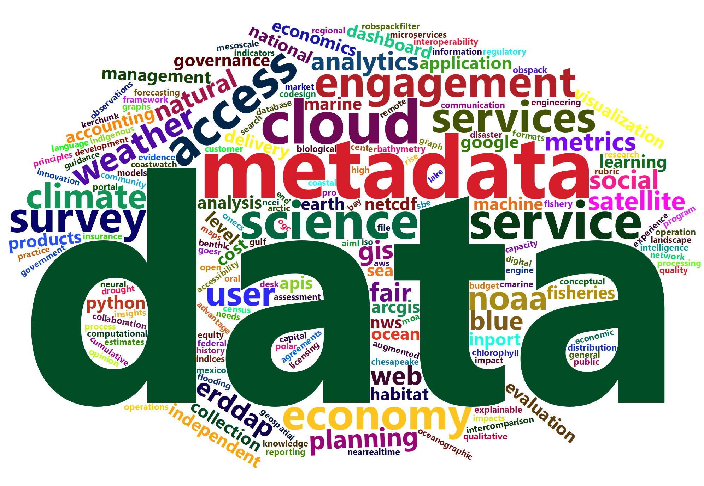
NOAA Data
Tony LaVoi
Chief Data Officer
April 26, 2023

Slide 2
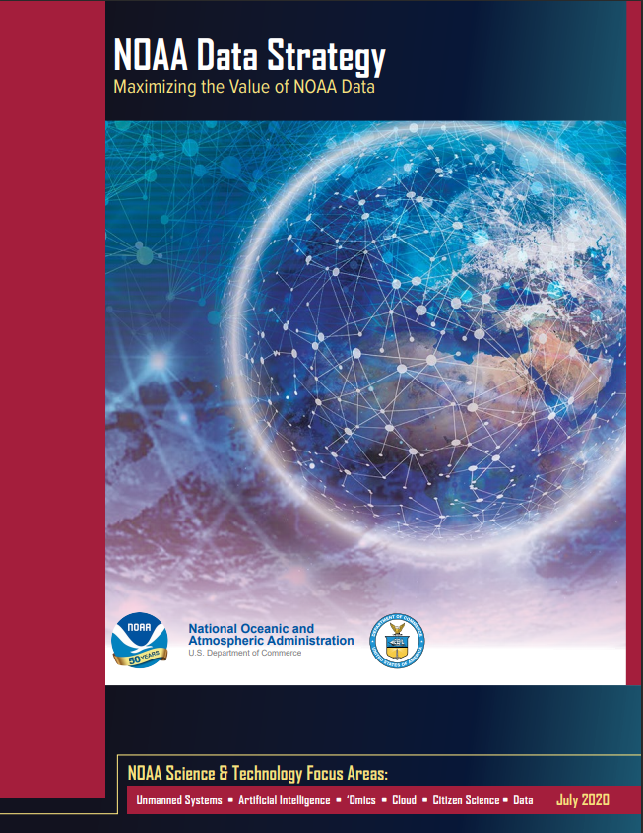
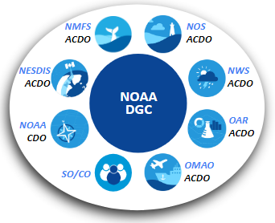
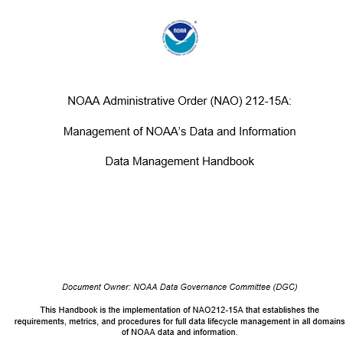
Enhancing Access to NOAA’s Open Data
The purpose of the NOAA Data Strategy is to dramatically accelerate the use of data across the agency and with other key partners, maximize openness and transparency, deliver on mission, and steward resources while protecting quality, integrity, security, privacy, and confidentiality.
NOAA Data Strategy
NOAA Data Governance Committee (DGC)
NOAA Data Management Handbook

Slide 3
NOAA CDO Framework
Foundations for Evidence-Based Policymaking Act of 2018 (Evidence Act) directed federal agencies to appoint a Chief Data Officer (CDO) and take specific actions for improving access to high-quality government data, with the goal to enhance decision-making about important programs and the availability of open data for the American people
Organizationally placed the CDO within the Office of the Chief Information Officer - report to NOAA CIO
Member of NOAA CIO Council, Science Council, and Observing Systems Councils
DOC roles: NOAA Open Government Senior Lead and DOC Senior Agency Official for Geospatial Information

Slide 4
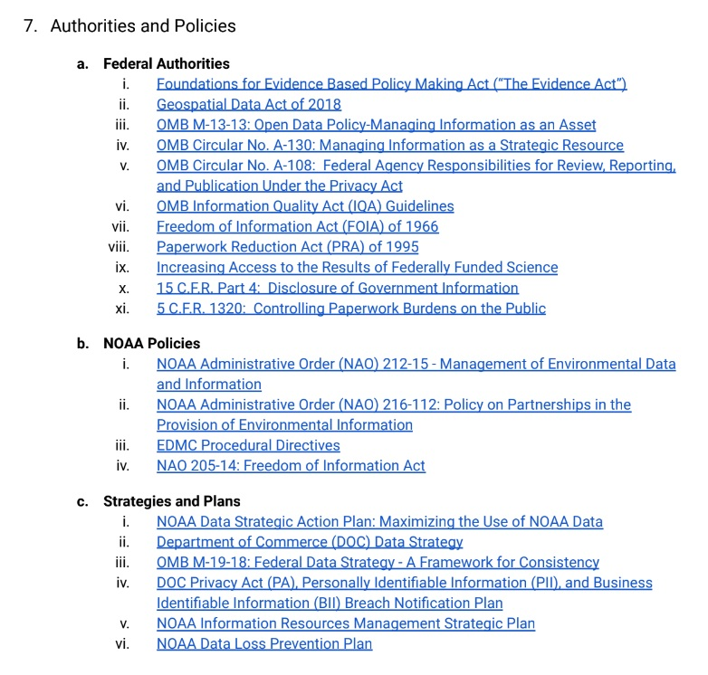
Where FOIA Fits?
OCIO/NOAA Enterprise Data Division (in approval stage)
Government Information Systems Program
Freedom of Information Act (FOIA)
Privacy Act of 1974
Paperwork Reduction Act (PRA)
Information Quality Act (IQA)

Slide 5
FOIA
NOAA CDO is the senior lead for FOIA
Building a Gov’t Information Systems portfolio with FOIA as a key component
FOIA liaisons collaborative approach is a model for other NOAA data and information service areas
Impressed with commitment to learning and information sharing among the FOIA community
FOIA proactive disclosure = spirit of open data
Active DOC coordination and leadership
NOAA Program Management Council (PMC) - Transition to FOIAXpress

