Slide 1
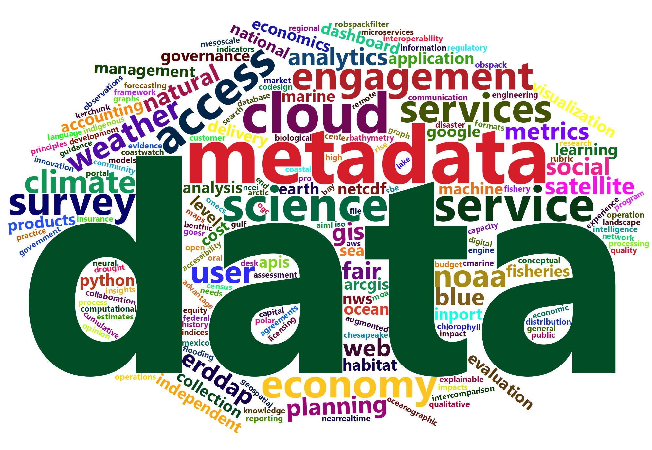
NOAA Data
Tony LaVoi
Chief Data Officer
April 25, 2023

Slide 2




NOAA Priorities
Science, Service and Stewardship
Climate
Establish that NOAA is the primary authoritative source for climate products and services that can be applied to a diverse range of missions, just as we are for weather.
Balance
Advance NOAA’s complementary work on environmental stewardship and economic development with a particular focus on the New Blue Economy.
Equity
Exhibit equity in how we build and provide services. Within NOAA, we will promote diversity, equity, inclusion and accessibility in the workforce. Externally, we will provide equitable access to our products and services.
EQUITABLE AND OPEN ACCESS TO OUR DATA, INFORMATION, AND SERVICES DRIVES THE MISSION

Slide 3
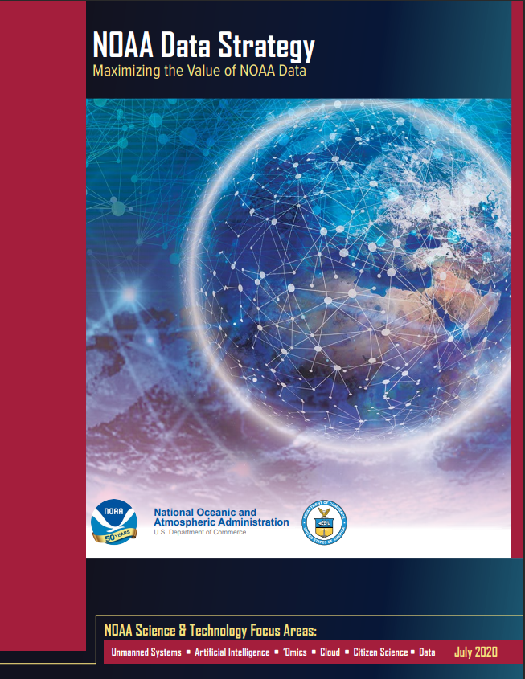
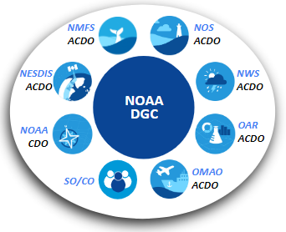
NOAA Data Strategy
The purpose of the NOAA Data Strategy is to dramatically accelerate the use of data across the agency and with other key partners, maximize openness and transparency, deliver on mission, and steward resources while protecting quality, integrity, security, privacy, and confidentiality.
NOAA Data Governance Committee (DGC)

Slide 4
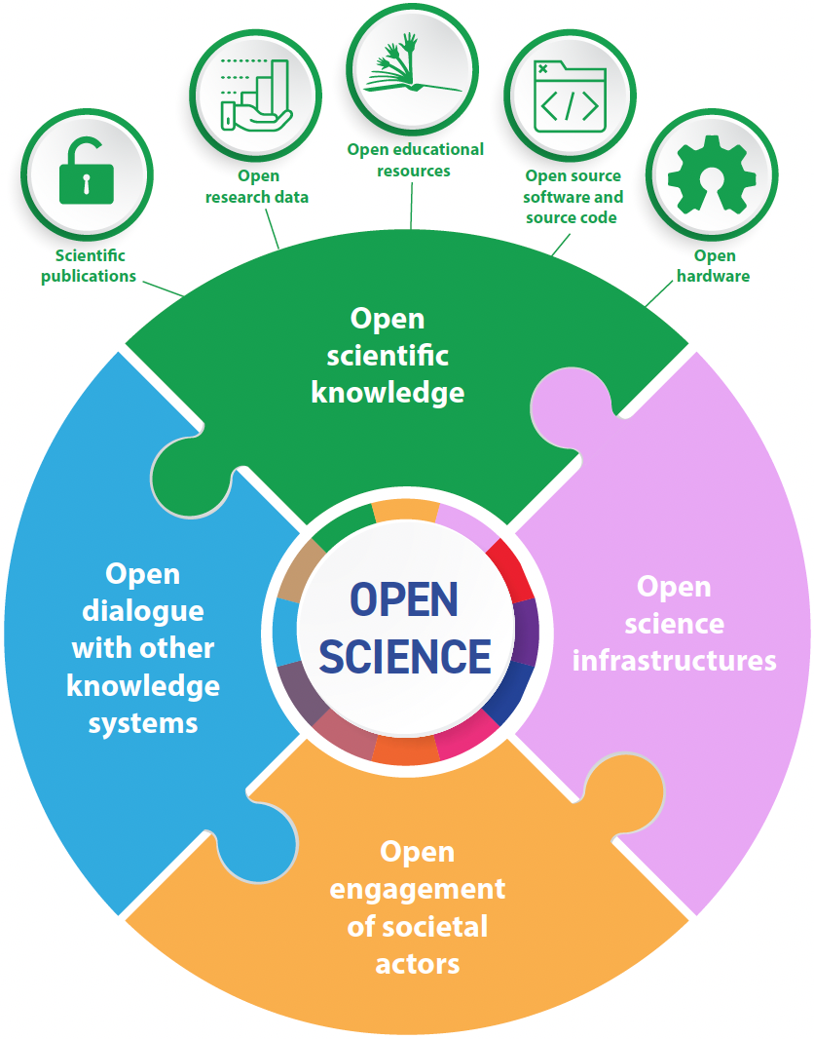
NOAA Open Data / Open Science Landscape
White House “2023 is the Year of Open Science”
Federal Open Data Policies and Executive Orders
FAIR Principles: Findable, Accessible, Interoperable, and Reusable
Emphasis on Equitable Access to Agency Data
Data to Support Artificial Intelligence and Machine Learning (AI/ML)
Source: UNESCO Recommendation on Open Science

Slide 5
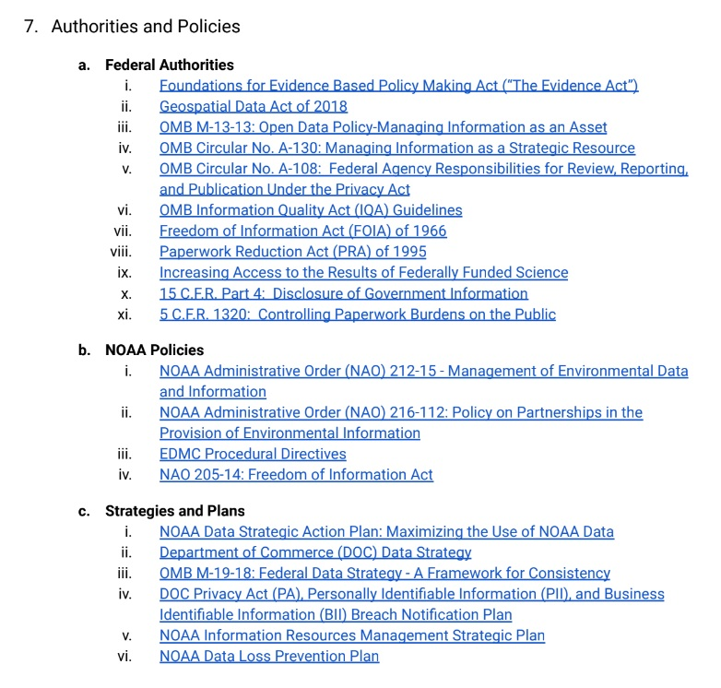
Data Policy Framework
Open and Secure
Evidence-Based Policy Making Act
Freedom of Information Act (FOIA)
Privacy Act of 1974
Paperwork Reduction Act (PRA)
Information Quality Act (IQA)
NOAA Data Strategy Objective 3.4 - Share data as freely as possible to enable their use, while protecting privacy, confidentiality, and and integrity. Adopt tiered data access practices to protect sensitive and confidential data and respect the rights of individuals and businesses.

