Slide 1

ProTech Oceans Domain
Post-Award Conference / Kick-Off Meeting
February 14, 2019

Slide 2
ProTech Office POCs
Jay Standring
Professional Technical Services (ProTech) Branch Chief
Erika Chavarria
Contracting Officer, ProTech Oceans Domain
Regina Evans
Contracting Officer’s Representative, ProTech Oceans Domain

Slide 3
Contract Details Overview
Indefinite-Delivery, Indefinite-Quantity (IDIQ) contract with multiple awards
Base Period of Performance (POP) February 01, 2019 through January 31, 2021
Option Periods:
Option 1 - February 01, 2021 through January 31, 2022
Option 2 - February 01, 2022 through January 31, 2023
Option 3 - February 01, 2023 through January 31, 2024

Slide 4
Contract Details Overview
Base IDIQ Contract, Section F - Deliverables
F.6.1 - Monthly Progress Report
F.6.2 - Monthly Task Order Status Report
Escalation Plan - Due May 01, 2019

Slide 5
Contract Details Overview
G.8 NON-PERSONAL SERVICES
No personal services, as defined by FAR 37.104, shall be performed under ProTech Oceans.
No Contractor employee will be directly supervised by the Government.

Slide 6
Monthly Contract Progress Report
Contractor shall provide a Monthly Contract Progress Report (MCPR) as a summation of individual Task Order (TO) activity covering activity from the previous month (i.e. June report covers May activity)
MCPR documents the Contractor’s TO awards and modifications received during the reporting period and includes significant activities, issues, corrective actions (if any), and planned significant activity projection for the next 60 day period
MCPR submitted on Attachment J-4 due NLT COB of the 15th calendar day of the month
If the 15th calendar day of the month falls on a weekend or holiday, report is due the following business day
MCPR shall be submitted electronically, via email to:
NOAA Oceans Domain IDIQ Contracting Officer (CO)
NOAA Oceans Contracting Officer’s Representative (COR)
Subject line of the email submission of the MCPR shall state Monthly Contract Progress Report and include the contract number, month, and year

Slide 7
Monthly TO Progress Report
Contractor shall provide a Monthly TO Progress Report (MTOPR) documenting the Contractor’s TO modifications received during the reporting period and covering activity from previous month (i.e. report submitted in June covers May activity)
MTOPR documents activities, issues, corrective actions (if any), and planned significant activities projected for the next 60 days
MTOPR submitted in Adobe Format NLT COB of the 15th calendar day of the month
If the 15th calendar day of the month falls on a weekend or holiday, report is due the first following business day
MTOPR shall be submitted electronically, via email to:
NOAA Oceans Domain IDIQ Contracting Officer (CO)
Ordering Contract Officer (OCO)
Contracting Officer’s Representative (COR) for the specific task (TO COR)
Subject line of the email submission of the MTOPR shall state Monthly Task Order Progress Report and include the TO Number, month, and year
If there is no TO activity during the reporting period, the MTOPR shall still be submitted and state “no activity”

Slide 8
Contract Details cont’d
Contract provides for individual task orders, which may be:
Firm-Fixed-Price (FFP)
Cost Reimbursement
Time and Materials (T&M)
Labor Hour (LH) basis
Task orders may combine more than one pricing arrangement

Slide 9
Ordering Process
All vendors will be provided a fair opportunity to be considered on TOs
The OCO and TO COR will review the capabilities of vendors to determine if a small business or other socio-economic category set-aside is appropriate. This review will be coordinated with the NOAA Small Business Office and the Small Business Administration (SBA)
After completing a review, the OCO may limit competition for an order to small businesses or a socio-economic category
If a set-aside is appropriate, the OCO solicits proposals from the vendors in the appropriate small business category
If a set-aside is not appropriate, the OCO will open the competition to all contract holders
If issues pertaining to a proposed task cannot be resolved to the satisfaction of the OCO, the OCO reserves the right to withdraw and cancel the proposed task. In this event, the Contractor(s) shall be notified in writing of the OCO’s decision

Slide 10
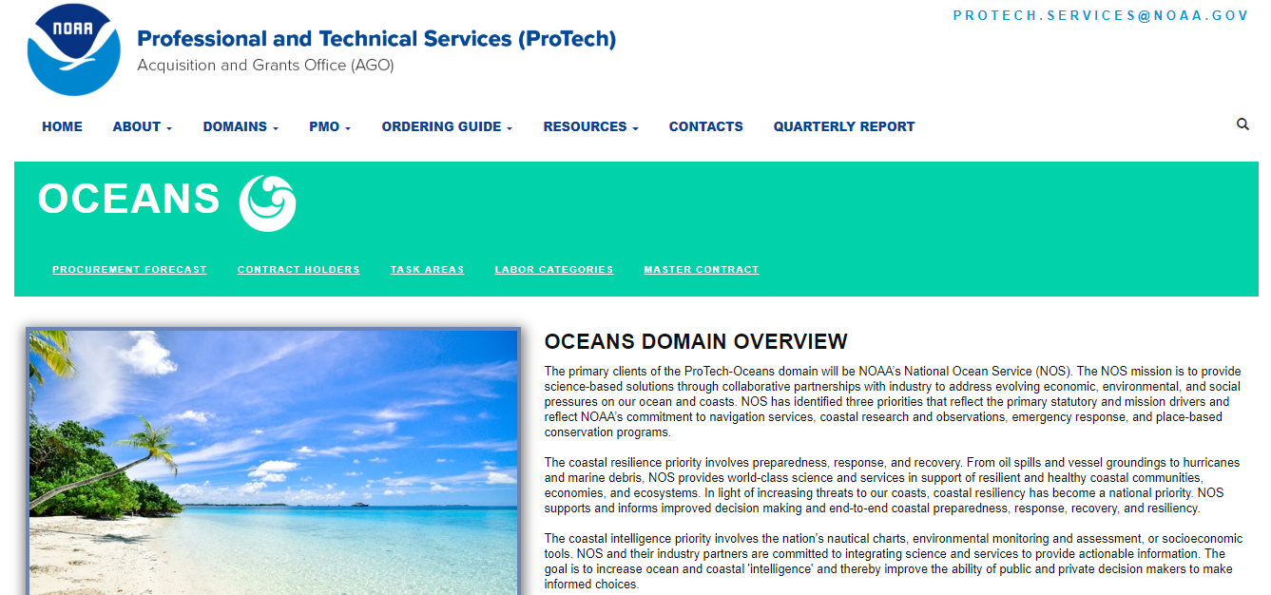
ProTech Website
www.protechservices.noaa.gov

Slide 11
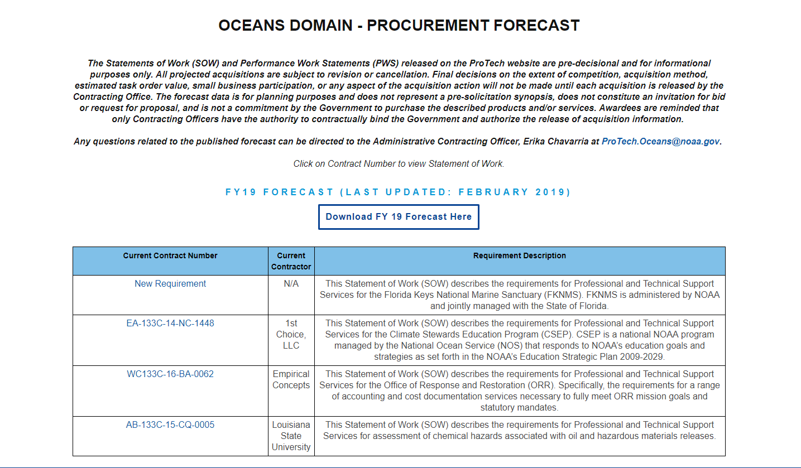
ProTech Website

Slide 12

Upcoming Engagement Events
Opportunity to meet the NOS Region personnel, ask questions. discuss capabilities, demonstrate innovation, commitment to NOAA, etc…

Slide 13
Questions

