Slide 1

NOAA Acquisition & Grants Office (AGO)
Professional And Technical (ProTech) Services Oceans Domain Post-Award Conference
February 14, 2019
Marcelle Loveday, SSAD Director

Slide 2



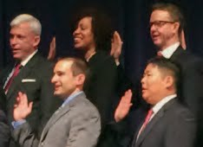

Department of Commerce
Strategic Plan
ACCELERATE AMERICAN LEADERSHIP
  Expand Commercial Space Activities
  Advance Innovation
  Strengthen Intellectual Property Protection
FULFILL CONSTITUTIONAL REQUIREMENTS AND SUPPORT ECONOMIC ACTIVITY
  Conduct a Complete and Accurate Decennial Census
  Provide Accurate Data to Support Economic Activity
ENHANCE JOB CREATION
  Increase Aquaculture Production
  Reduce and Streamline Regulations
  Strengthen Domestic Commerce and the U.S. Industrial Base
  Increase U.S. Exports
  Increase Inward Investment Into the United States
DELIVER CUSTOMER-CENTRIC SERVICE EXCELLENCE
  Engage Commerce Employees
  Accelerate IT Modernization
  Consolidate Functions for Cost Savings
STRENGTHEN U.S. ECONOMIC AND NATIONAL SECURITY
  Enforce the Nation’s Trade Laws and Security Laws
  Enhance the Nation’s Cybersecurity
  Reduce Extreme Weather Impacts
  Deploy Public Safety Broadband

Slide 3
NOAA Primary Objectives
Lead the world in earth system observation and prediction to enhance the nation's economy
Minimize the impacts of severe weather by implementing Public Law 115-25 (Weather Research and Forecasting Innovation Act)
Increase the sustainable contributions to the nation's economy through fishery and marine resource management, mapping, exploration, observation, and prediction

Slide 4
AGO Goals
Balance Mission and Fiduciary Duty
Support the NOAA Mission
Protect the public interest
Seek efficiency and effectiveness
Operate with integrity and transparency
Management
Move from service delivery to core competency
Provide Line/Staff Offices with support throughout the Financial Assistance lifecycle
Build industry partnerships through strategic sourcing & consolidation
Expand acquisition beyond formation to management

Slide 5
AGO Organization Chart
AGO Director’s Office
Jeffrey Thomas, Director
Kelly Mabe, Deputy Director
David G. Price, Chief of Staff
Ombudsman / Risk Manager
Rafael Roman
Small Business
Jeffrey Hale
Natalie Colbert
Policy & Oversight Division
W. Chad Wagner
Staff Services Management Division
David G. Price
Grants Management Division
Arlene Simpson Porter
Strategic Sourcing Acquisition Division
Marcelle Loveday
Satellite & Information Acquisition Division
Rafael Rivera
Eastern Acquisition Division
Jack Salmon
Western Acquisition Division
Chad Hepp

Slide 6






NOAA’s Strategic Sourcing Goals
Improve outcomes
Increase use of performance-based techniques
Accelerate & deepen understanding
Establish partnerships
Streamline processes
Reduce administrative time
Notes:
© Copyright PresentationGO.com

Slide 7
Build an Industrial Base of Partners
Small – Medium – Large Organizations
Capability Model
Business Model
Best Value Tradeoff
HIGHER
FLUFF
Veneered
Credentialed
Episodic
TALENT
Niche
Scarce
Valuable
HIGHER
HOSTAGE
Dominant
Protected
Insulated
PARTNER
Client Focused
Enduring
Reciprocal
Cost
Profit
WASTELAND
Transactional
Short Term
Limited
COMMON
Efficient
Effective
Repeatable
VENDOR
Limited
Constrained
Alienated
Rapport less
SUPPLIER
Undifferentiated
Commercial
Staff Augmentation
LOWER
LOWER
LPTA
Competency
Competition
LOWER
HIGHER
LOWER
HIGHER
A Race to the Bottom Hurts Everyone
Margin Drives Investment, Recruitment, Retention, and Esprit de Corps
Partnership Thrives on Communication, Cooperation, and Duration

Slide 8

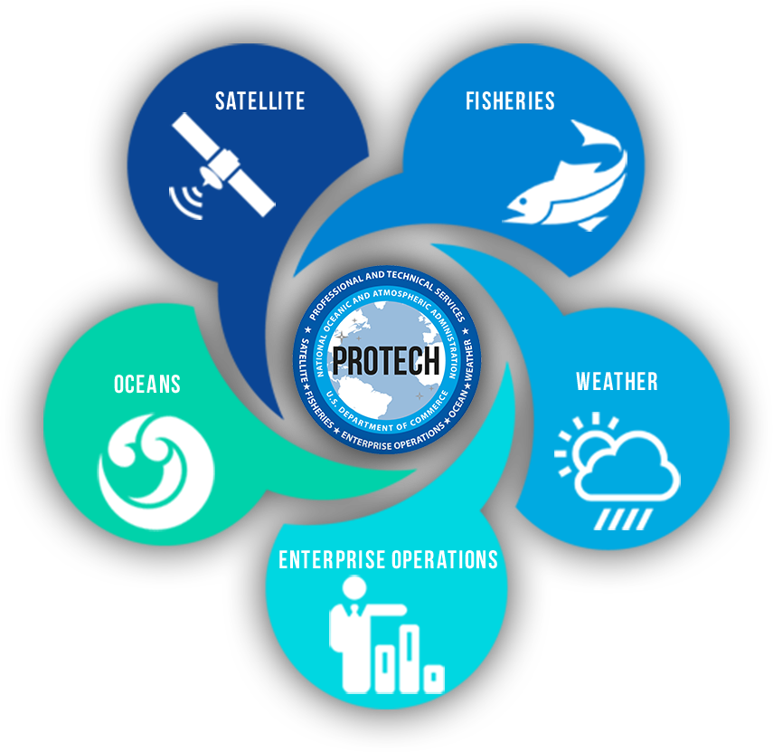
NOAA’s Strategic Sourcing Initiatives
  NOAALink: NOAA-wide IT initiative
    Core suite of Small Business IT services contracts
    Period of Performance 9/2010 – 9/2020
    Includes enterprise-wide contracts for commodity software and hardware products
  ProTech: Domain-specific professional & technical services solution
    Suite of IDIQ contracts, $3 Billion shared ceiling
    Five year period of performance for most Domains
    Satellite Domain – Awarded June 2017
    Fisheries Domain – Awarded September 2018
    Oceans Domain – Awarded February 2019
    Weather Domain – Award anticipated Q3/4 FY19
    Enterprise Operations Domain – new strategy Aug 2018

